Slide 1
Notes:
JB and EB (see script)
Mention that we will have time for questions
Serious topics but wanted to bring a bit of fun to Friday afternoon
Background notes: Invite for Results Redezvous
Declining Medicaid enrollment?
The state’s opioid crisis?
The uptick in employer-sponsored insurance?
The implications for the state’s new “public option” for health insurance?
The Coloradans who continue to struggle amid a booming economy?

Slide 2
CHAS: Measuring Policy Impact Since 2008
Notes:
JB (See script, change to this slide during this component☺
Jeff: We’re excited to share new insights from the CHAS for many hot policy topics — many of which we discussed at the Hot Issues conference — as well as stories behind the data and how the CHAS is an essential tool to inform policy decisions. We will be going over some pretty serious findings today, but we also know it’s Friday afternoon. So, without detracting from the findings, we thought we’d have some fun with our favorite survey-based game show, Friendly Feud. We don’t Let’s introduce our teams!
Different picture
Context for upcoming topics and current policy implications
Acknowledgment of topics at conference

Slide 3
Notes:
EB/Announcer/Game Show #1
“What are the top reasons why we moved away from phone surveys?”
Animation order:
Decline of landlines
Not answering unknown numbers
“X” appears
“X” disappears (auto)
The cost
Too many robocalls
Federal regulations
Call blocking technology
Surveys are annoying

Slide 4
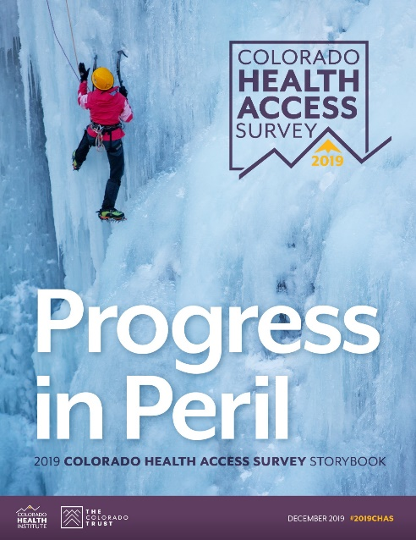
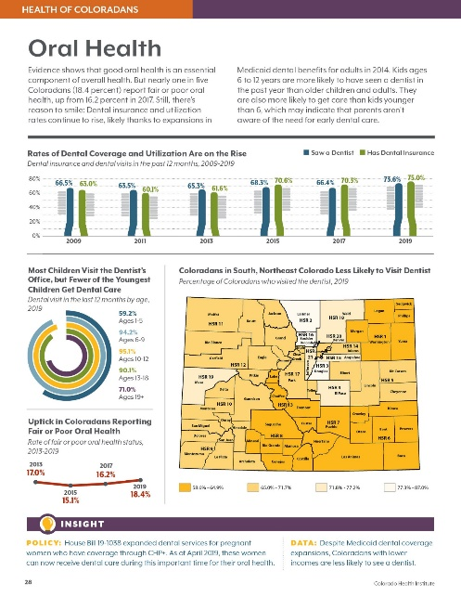
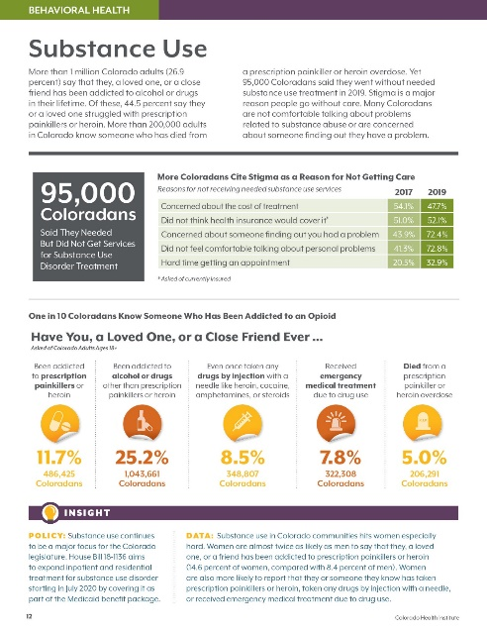
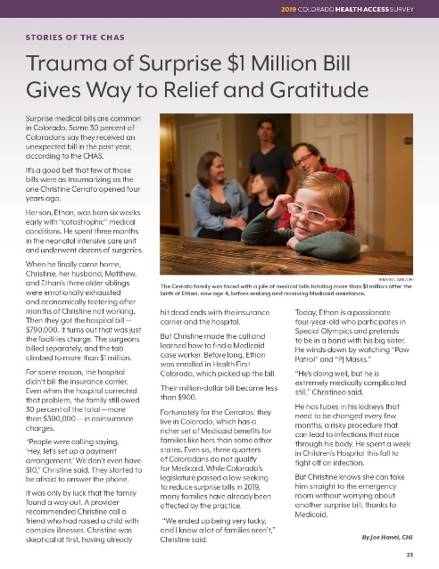
What is the CHAS?
Notes:
JB
We gain these insights through a representative survey of 10,000, administered in English and Spanish, conducted every two years
Between Feb – Jun 2019
We sample it for each of the state’s 21 HSRs
This is a rich data set that asks questions not only on health insurance, but access to services, use of care, affordability, health status, behavioral health and social determinants such as housing, food security, and unfair treatment.

Slide 5
Notes:
JB
All of these efforts and the community asset that is the CHAS couldn’t be realized without the generous support of TCT and CHF.
We’d also like to thank the OBH and HCPF for sponsoring specific items on the CHAS this year.

Slide 6
Insights From the CHAS
Coverage
Access and Affordability
Mental Health Care
Oral Health
Housing
Food
Unfair Treatment
Notes:
EB
Building off the Sept launch, providing seven policy insights
There’s a lot more data in the chartpack (handed out at end)

Slide 7
Coverage: Still Waters Run Deep
Notes:
EB
So let’s dive in!
The main headline from the CHAS is that the uninsured rate didn’t change between 2017 and 2019.
Who remembers what it was? (audience)
6.5%
We identified the theme of “still waters” because just because the uninsured rate didn’t change, we believe it was masking some underlaying market dynamics

Slide 8
A Changing Health Coverage Landscape
Health Insurance Coverage, All Ages, 2017-2019
Source: 2019 Colorado Health Access Survey
Notes:
EB
I’ll explain what I mean. Each bar here represents 100% of the state.
6.5% (red bars) uninsured
We also saw an increase in ESI (green bars), which we suspect has to do with the improving economy.
We also saw a slight dip in Medicaid, but while this was not a statistically significant change, we do know that Medicaid has been decreasing from administrative records from the CO Dept of Health Care Policy and Financing.
And in particular, we saw a decrease among children, specifically Hispanic and LatinX children.
In fact, we saw an increase in their uninsured rate fom x% to y%..
Contextual points:
Findings could be due to the improved economy as Colorado has a low unemployment rate, companies are offering benefits to attract and retain workers, and fewer people finding themselves eligible for Medicaid.
The decline in Medicaid is consistent with what we are hearing across the state from safety net clinics: decline in Medicaid, though they are also seeing an increase in uninsured. Is it possible that people are letting their coverage lapse? Or indicate they don’t have Medicaid when they seek care?
Census Bureau data show Colorado’s uninsured rate and number stayed steady at 7.5%, despite an increase in uninsurance nationally.

Slide 9
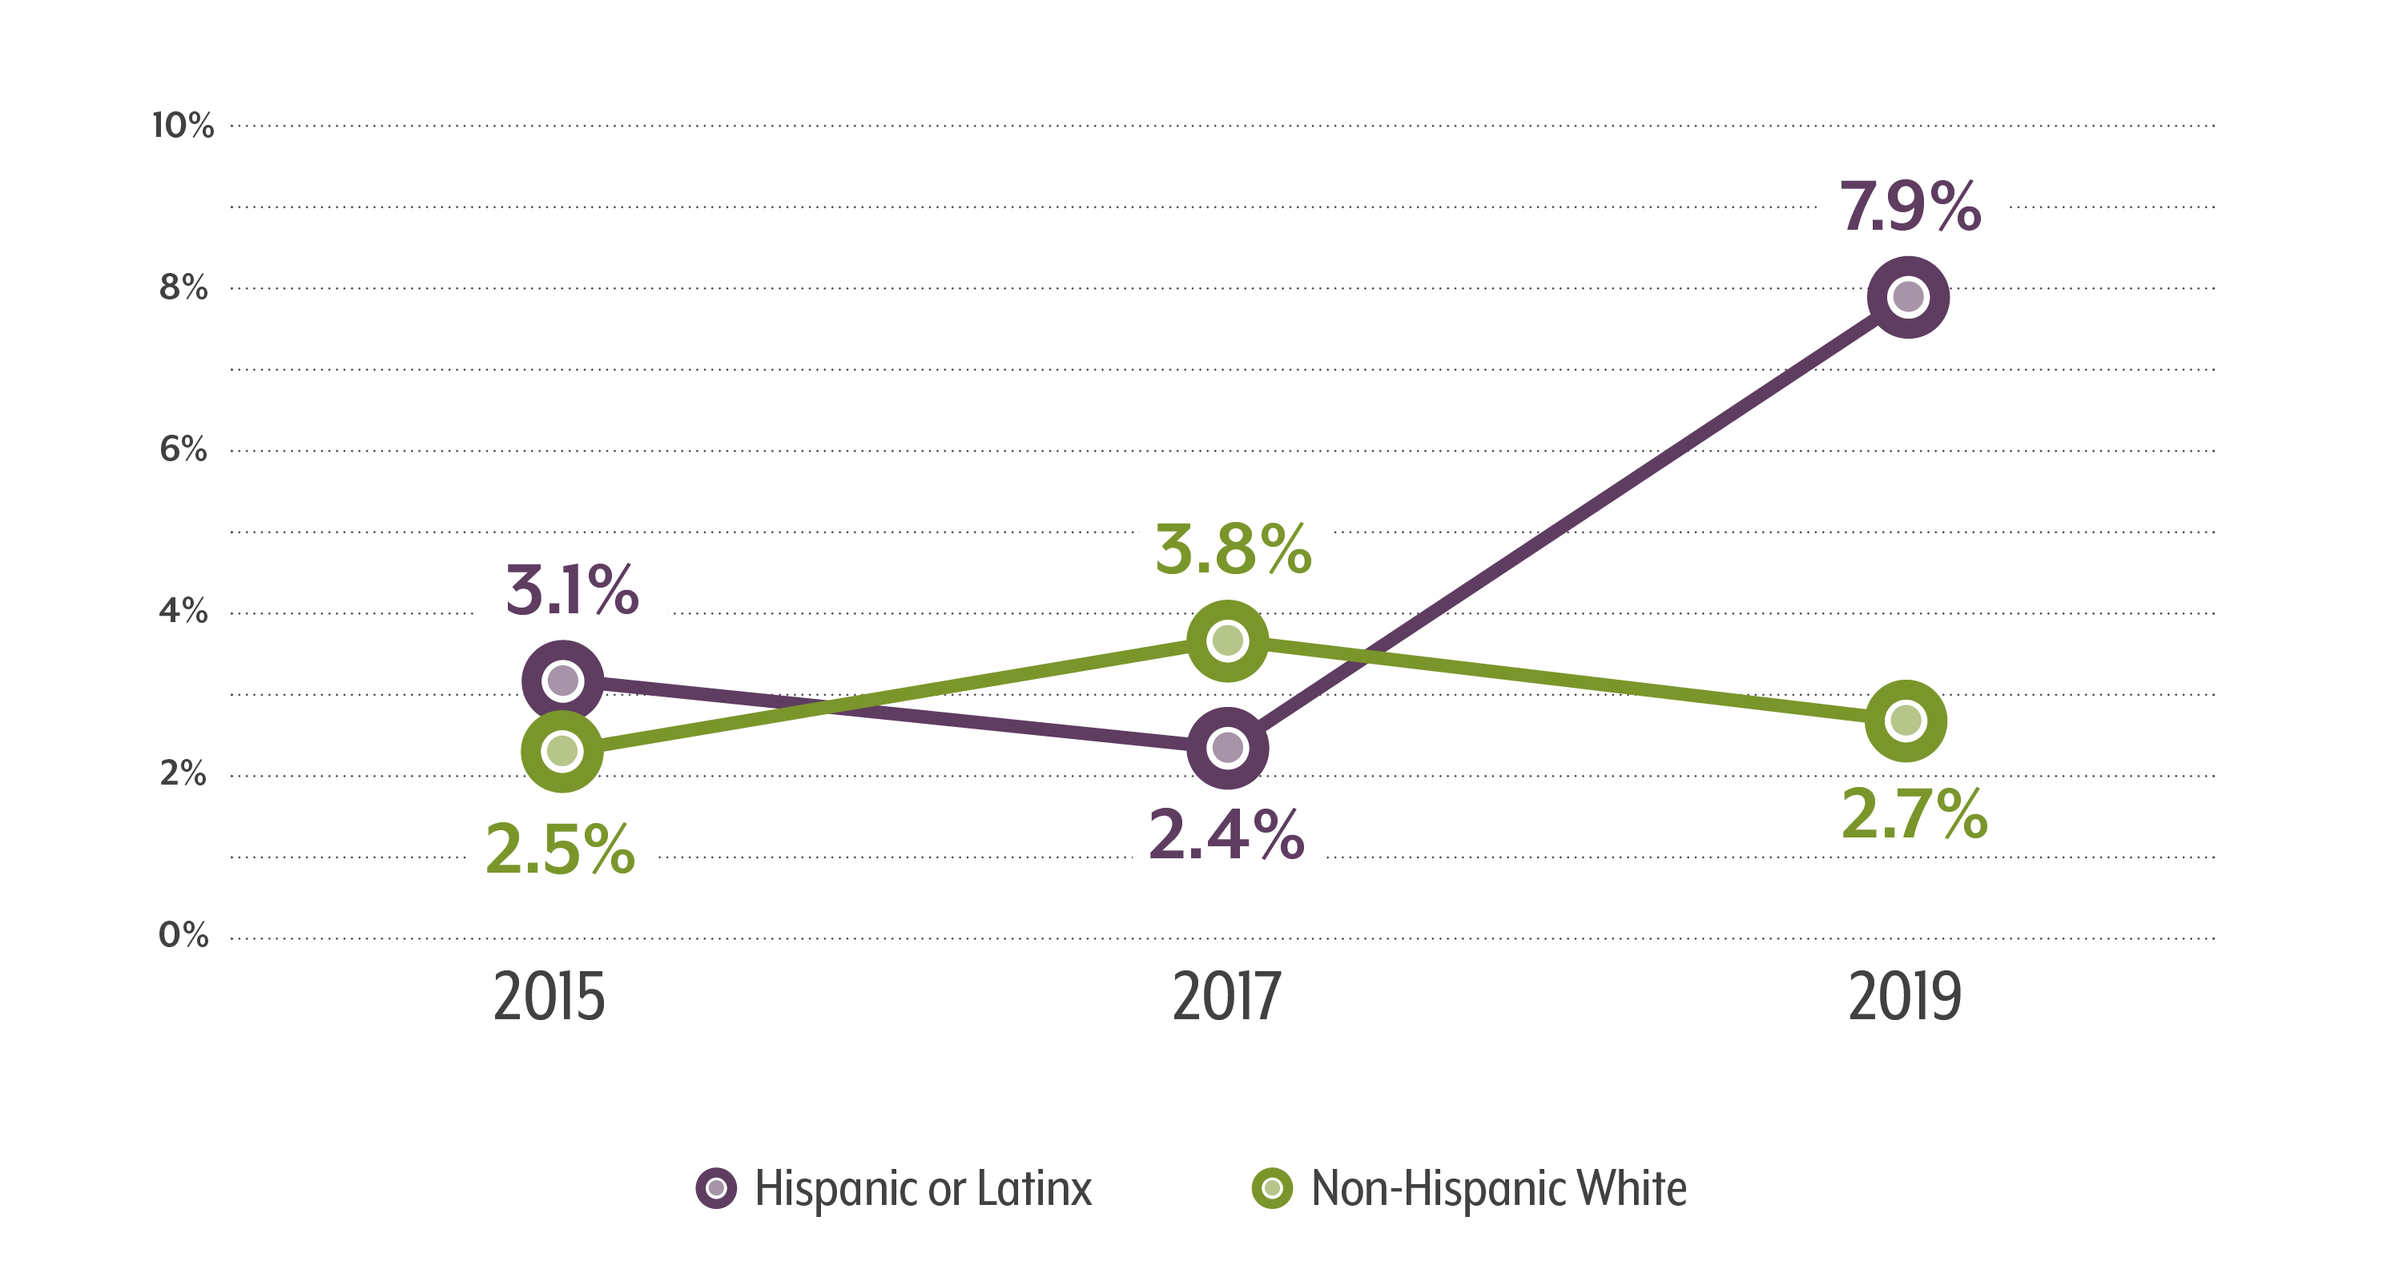
Uninsured Rate Increases for Hispanic or Latinx Children
Percent of Uninsured Colorado Children by Race/Ethnicity
Source: 2019 Colorado Health Access Survey

Slide 10
Drop in Medicaid, Uninsured Increase Concerns Clinics
Notes:
EB
We have been hearing from a lot of our partners in the HC safety net about this change
We felt it was important to highlight this in the chartpack
See story from every child Pediatrics and Mountain Family Health in the chartpacks that you’ll get at the end of the session
Story #1: Uninsured Kids
Include
To address decrease in Medicaid teaser we put in the invite
Just call-out
Include photo from chartpack

Slide 11
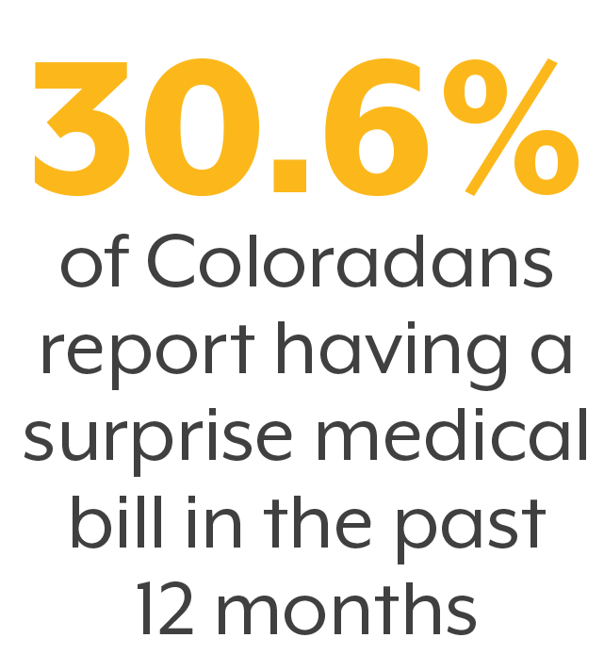
Source: 2019 Colorado Health Access Survey
Source: 2019 Colorado Health Access Survey
Notes:
EB
And just a reminder that it’s not all about whether someone has or lacks insurance, because even with insurance, 30% get hit with a surprise bill. There’s a story about that in the chartpack as well.
Now let’s look at what the CHAS tells us about the intersection of coverage, affordability, and access (turn over to JB)

Slide 12
Access and Affordability: Re(de)fining the Recipe
Notes:
JB
(Title subject to change!)
CHAS provides many insights into access and affordability
When we analyzed these metrics, there was an interesting pattern that emerged

Slide 13
Access and Networks: ESI and Medicare Do Best
Did Not Get Care Because Doctor Did Not Accept Your Insurance, 2019
Source: 2019 Colorado Health Access Survey
Notes:
JB
For example, this is a metric of the % of Coloradans who did not get care because doctor did not accept their insurance
Note Individual and MK, Medicare and ESI
Consideration: network adequacy

Slide 14
Medicaid and Individual Enrollees Still Report Cost Barrier
Did Not Get Specialist Care Due to Cost
Did Not Get a Prescription Due to Cost
Source: 2019 Colorado Health Access Survey
Notes:
JB
Tended to see this same pattern on metrics for cost too
With some exceptions
Go through each
Makes sense because Individual market may have more cost exposure; Medicaid serves Coloradans with low-income

Slide 15
Exploring Public Expansion
Notes:
EB
So, from the data we can tell it’s not whether insurance is public or private that causes Coloradans to report fewer barriers to care. CHAS data illustrates that it’s some other factors are at play.
Conversations between Democratic candidates largely focused on expanding public coverage stemming from ideas like Medicare for All, a public option, or some other plan.
Speaking of the Democratic candidates, we wanted to challenge the audience. For a prize, can anyone name all the candidates, or former candidates, on the screen? We know it is kind of hard to see each of them. *Audience engagement*
Great job, while all these candidates are/aren’t well known one thing most of them have in common is that their health care reform efforts focus on expanding coverage in the public sphere.
The question here is if there are ways we can try to capitalize on some of the success of Medicare when we’re looking at a broader public expansion.

Slide 16
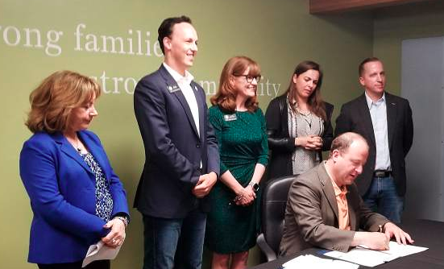
2019: The Year of Individual Market Levers
Public Option: Leveraging Regulatory Power
Peak Health Alliance: Increasing Community Negotiation
Reinsurance: Limiting Risk
Deepan Dutta/Summit Daily
Notes:
EB
Efforts in Colorado have been largely focused on the individual market. What are seeing in each of these efforts is an attempt to make the individual market look more like employer sponsored insurance, whether that’s the explicit goal or not.
Peak Health Alliance, a community health purchasing alliance that started in Summit county, assumes the role of negotiating rates for services directly with providers in the area to make care more affordable for local residents.
Reinsurance has lowered premiums on the individual market by a statewide average of 20 percent. This is accomplished largely by stabilizing risk for insurance carriers, therefore lowering prices for consumers.
And the Public Option, which might be better labeled a public/private option, will prompt large private market insurers to offer a state-designed plan. This effort leverages regulatory power from the Division of Insurance to try to increase competition, set affordable prices, and ensure that consumers ultimately realize the savings.
When we hear these types of discussion and debates it’s critical to ask what the considerations are, especially for our state.
Photo sources:
https://www.postindependent.com/news/colorado-gov-polis-signs-landmark-health-care-legislation-in-vail/
https://www.summitdaily.com/news/in-silverthorne-gov-jared-polis-signs-two-major-health-care-bills-into-law/
EB
While these public and private efforts pull on different levers to address access and affordability, there are universal considerations and areas where we can measure progress.
New models must ensure an adequate network for consumers to access care.
Covered services need to be comprehensive and relevant to consumer needs
However, providing an adequate network and covering needed services can’t come with too high of costs.
Finally, as long as insurers are providing insurance coverage, it will be critical to have the right amount of risk to calculate affordable premiums. Too much risk will mean insurers will raise prices. This is partly what reinsurance tries to address.
Just like with the implementation of the Affordable Care Act, the CHAS will be instrumental in providing a baseline and measuring Coloradans experience with new innovations at the state or federal level.
we will be interested to see how they interact with one another, and other innovations, moving forward and how we can use CHAS data to measure their impact.
So, as we’ve heard, the CHAS informs us about key insights on current policy issues. But there are many other applications of the data as well. And what better way to explore this than to play another round of…FRIENDLY FEUD!
***Photo from Peak Health Alliance brief

Slide 17
Notes:
JB
Second Family Feud session. This will focus on the top reasons people indicated they were uninsured.
Sample Questions: What are the often-reported reasons for being uninsured according to Coloradans?
Alternate question: What are the new items that were included on the 2019 CHAS?
Animation order:
Grantwriting
Needs assessments
Research
“X” appears
“X” disappears
Organizational or project priority-setting
Advocacy
Community or state level or state-level decision-making
Targeted education
Evaluation

Slide 18
Mental Health Care: The Pace of Parity
Notes:
EB
How can the CHAS inform discussions on mental health?

Slide 19
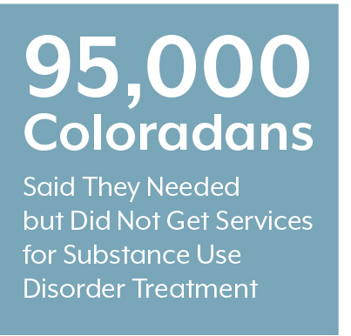
Behavioral Health Access Is Down
Source: 2019 Colorado Health Access Survey
Notes:
EB
First, on the downside, we saw more people reporting not getting needed mental health care or SUD care: the most ever since we started measure it in 2013.
13.5% of Coloradans report that they did not get needed mental health services in the past 12 months
2.3% reported not getting SUD services – represents 95,000 people (confirm number)

Slide 20
Steps to Leveling the Mental Health Playing Field
Mental Health Parity Act
Mental Health Parity and Addiction Equity Act
Affordable Care Act
Mental Health Parity Insurance Medicaid
Notes:
EB
Parity is one approach to try to address what we saw in the last graph: increase access by making it comparable to physical care and coverage
This discussion has been going on for some time…2019 saw another parity bill pass…
https://coloradosun.com/2019/03/27/colorado-mental-health-parity/

Slide 21
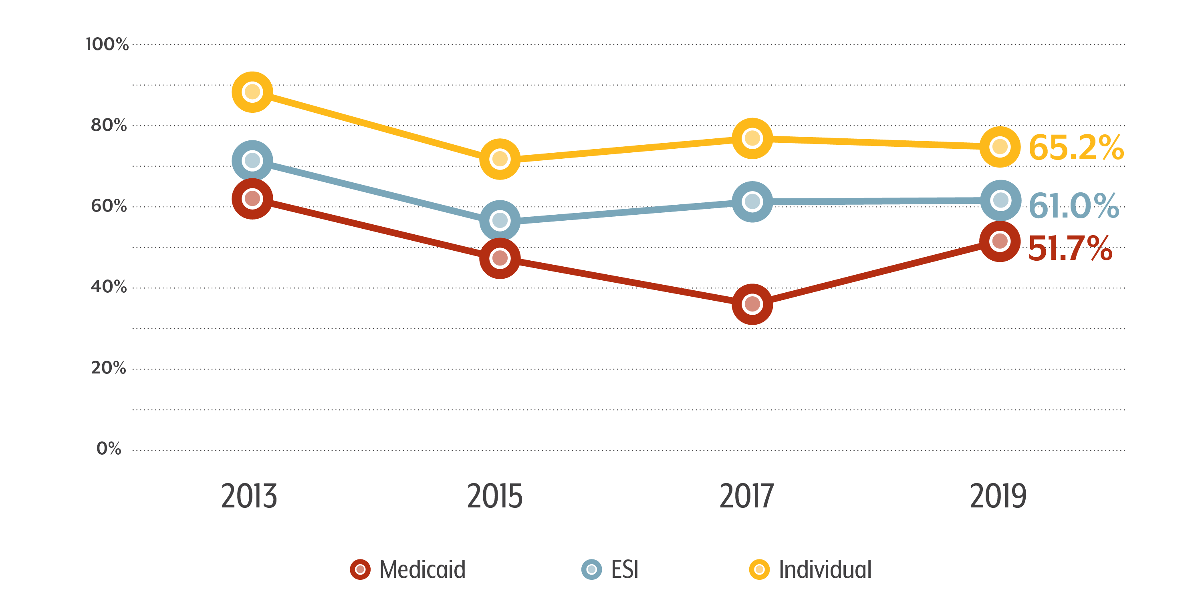
Concerns About Cost: A Downward Trend
Did Not Get Needed Mental Health Care Because of Cost
Source: 2019 Colorado Health Access Survey
Notes:
EB
To examine how the CHAS can inform parity, we took the cost item and broke it out by type of insurance
What’s remarkable is that for all three of these, we have seen a decrease since 2013. There is some fluctuation, but overall, a smaller percentage of people who say they didn’t get needed mental health services is citing cost
We can’t say this is due to parity exactly, but we do see an overall downward trend towards the 23% who cite cost as a reason for foregoing physical health care (doctor/specialist)

Slide 22
Mental Health Access Proves to Be a Complicated Question
Notes:
EB
Story #2: Mental health/Durango
Include photo from chartpack

Slide 23
Oral Health: The Case for Dental Therapy in Rural Colorado
Notes:
JB

Slide 24
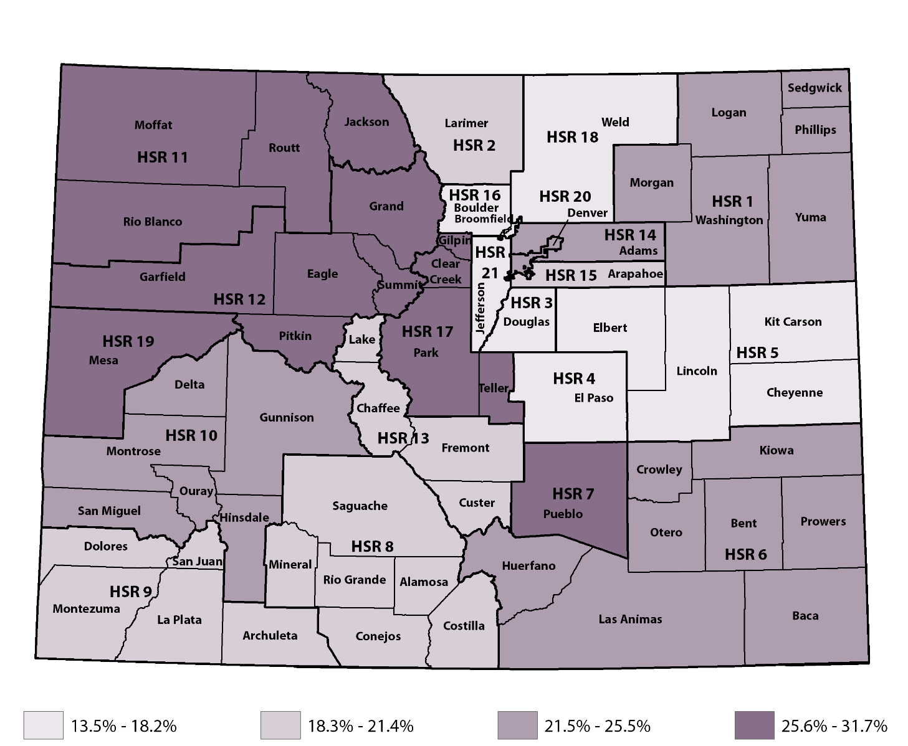
Northwest in Need: Foregone Dental Care Due to Cost
Colorado:
20.6%
Highest:
31.7% (HSR 12)
Lowest:
13.5% (HSR 3)
Source: 2019 Colorado Health Access Survey
Notes:
JB

Slide 25
Dental Therapy: An Idea Imported From Alaska
Colorado’s legislative, executive branches
Open to improved oral health care access
Notes:
JB
Explain dental therapy, goal is to reduce costs, increase access
Has been controversial
There have been some discussions starting
We looked at CHAS, asking, what areas of the state could potentially benefit from dental therapists
Sources:
https://www.wkkf.org/news-and-media/article/2014/06/a-decade-of-smiles-celebrating-ten-years-of-dental-therapists-in-Alaska
(Feel free to use other picture of dental therapists)
https://www.coloradopolitics.com/news/colorado-s-legislative-executive-branches-open-to-improved-oral-healthcare/article_fb58eaa4-f455-11e9-8478-5bf207936317.html#tncms-source=article-nav-next

Slide 26
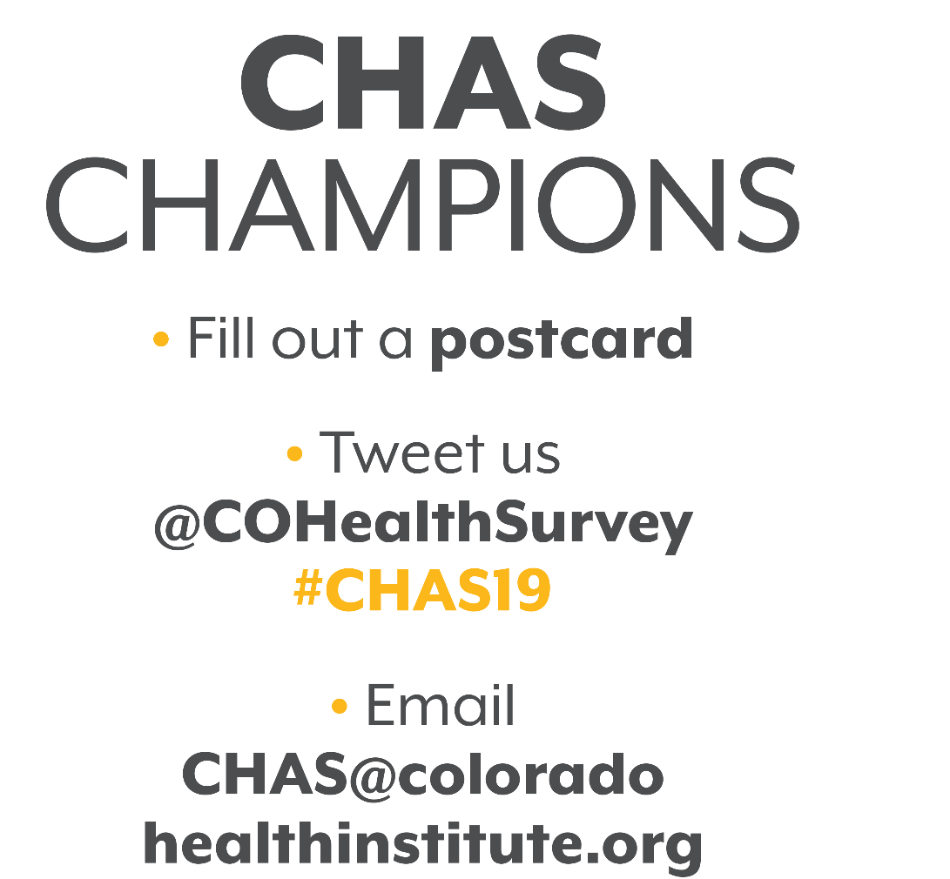
Notes:
JB? Kristi to provide some language. Open to creative ideas here!

Slide 27
Housing Instability: An Uphill Climb to Health and Home
Notes:
EB

Slide 28
The Linkage Between Housing and Health
Use chartpack graphic
GRAPHIC: People Facing Housing Instability Report Worse Overall, Mental, and Oral Health
Poor general health (44.1 housing unstable; 12.3 housing stable)
Poor mental health (45.8 housing unstable; 12.5 housing stable)
Poor oral health (46.8 housing unstable; 16.0 housing stable)
Source: 2019 Colorado Health Access Survey
Notes:
EB
Use graphic or call-out from chartpack

Slide 29
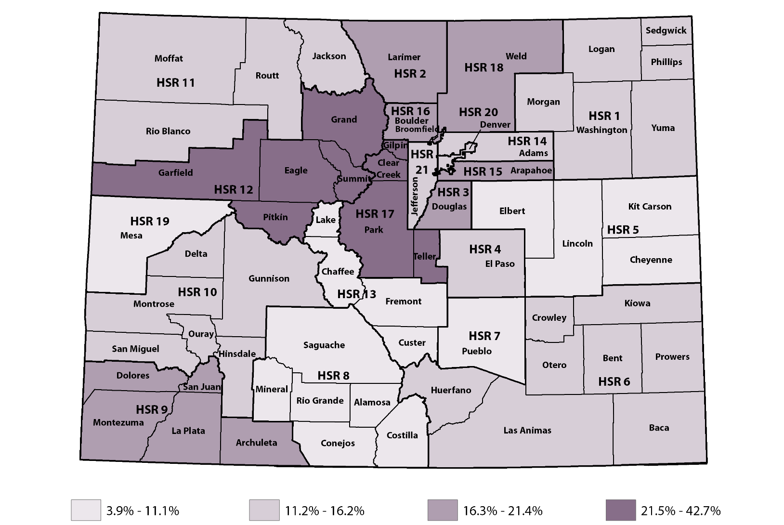
Mountain Renters Feeling the Crunch
Percent of Renters Experiencing Housing Instability, 2019
Coloradans Experiencing Housing Instability:
6.7%
Owners:
2.4%
Renters:
16.3%
Source: 2019 Colorado Health Access Survey
Notes:
EB
\\chi-fpe\public\Projects\Hot Issues in Health\2019 Conference\Presentations\CHAS\Mapping\Housing\Product

Slide 30
Eviction Prevention in the 2019 Legislature
HB19-1106: Rental Application Fees
HB19-1118: Time Period to Cure Lease Violation
HB19-1309: Mobile Home Park Act Oversight
SB19-225: Authorize Local Governments to Stabilize Rents
Notes:
EB
Highlight legislation, specifically geared toward evictions. Attempt to stabilize rents failed
Graphic from Housing paper

Slide 31
Food Insecurity: A Statewide Challenge
Notes:
EB

Slide 32
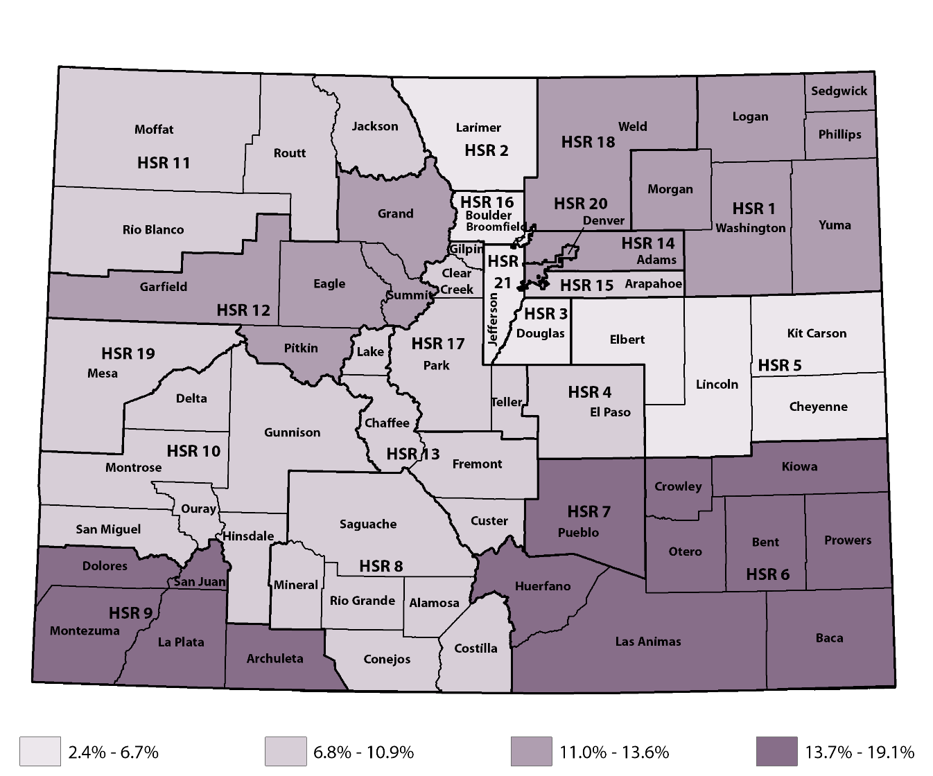
Hunger in Colorado
Percentage of respondents who ate less than they felt they should because there wasn’t enough money for food in the past year, 2019
Colorado:
9.6%
520,000
Source: 2019 Colorado Health Access Survey

Slide 33
Colorado’s Plan to End Hunger
Notes:
EB – these findings are coming amid the development of a new Blueprint to end hunger. While the Blueprint is intended to address Coloradans of all ages, we noticed call-out to seniors and children. They are particularly vulnerable, of course, and we’d highlight the need to address it among young adults too.
https://www.endhungerco.org/the-report

Slide 34
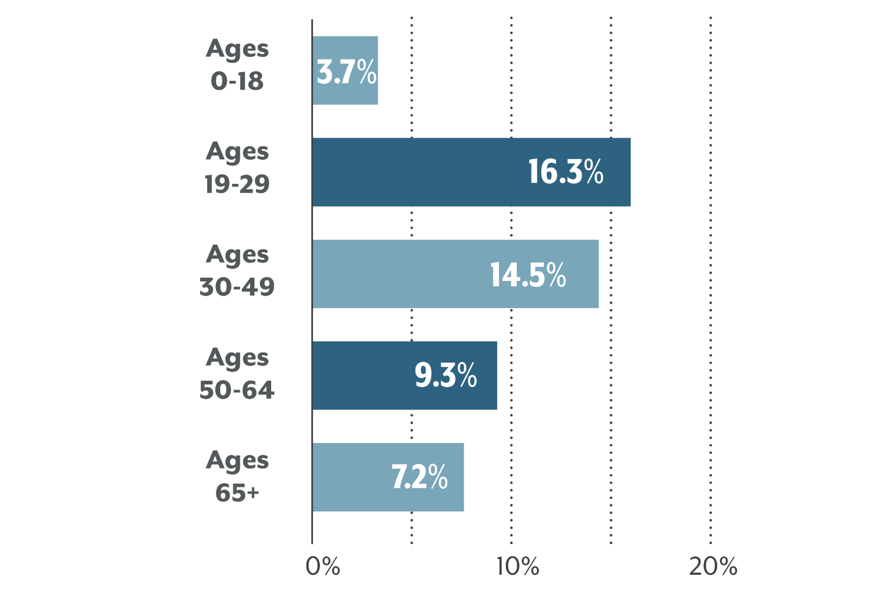
Coloradans Most Likely to Skip Needed Food
Use chartpack graphic
Source: 2019 Colorado Health Access Survey
Notes:
EB
Use graphic from Chartpack

Slide 35
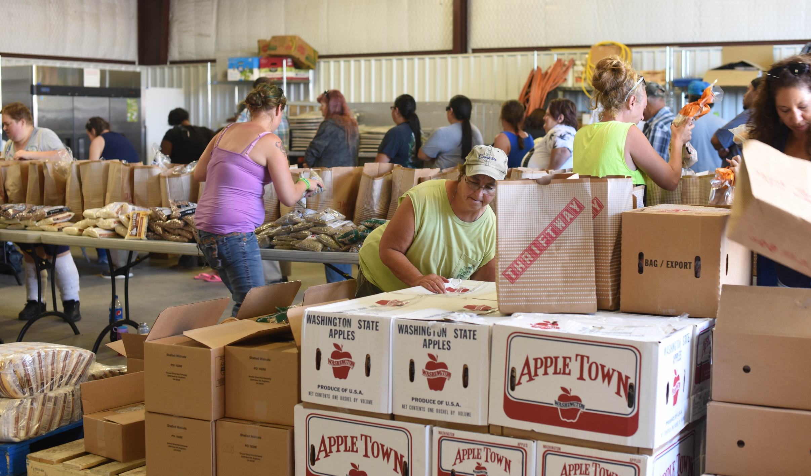
Addressing Food Insecurity on the High Plains
Notes:
EB
Story #3: Bent County Food Pantry
Include photo from chartpack

Slide 36
Unfair Treatment: A Wake-up Call for Health Care
Notes:
JB
Another social determinant – perceptions of unfair treatment
New items on the CHAS
Contextual points:
Discrimination as a social determinant of health.

Slide 37
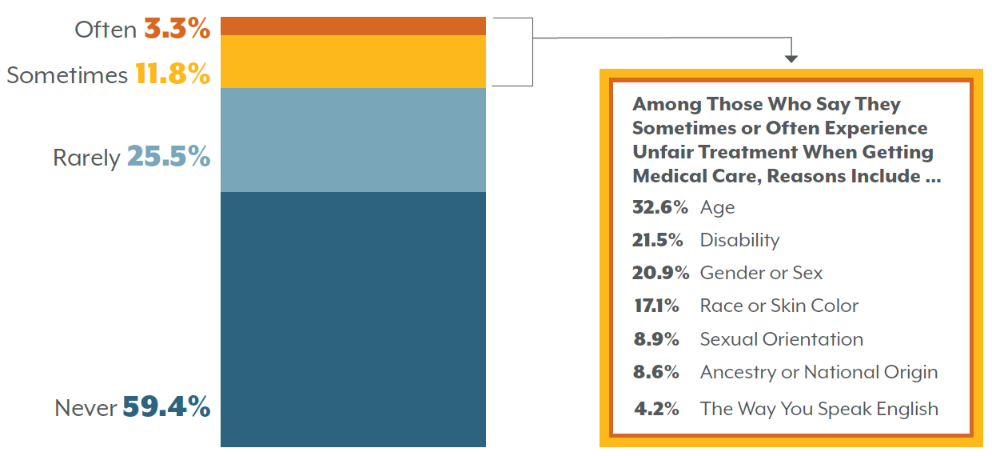
Colorado Adults Who Report Being Treated Unfairly When Getting Medical Care
Use chartpack graphic
Reasons Coloradans Think They Have Been Treated Unfairly When Getting Medical Care
Age | 32.6%
Disability | 21.5%
Gender or Sex | 20.9%
Race or Skin Color | 17.1%
Sexual Orientation | 8.9%
Ancestry or National Origin | 8.6%
The Way You Speak English | 4.2%
94.0% or
578,000
Coloradans
Experienced Stress from Unfair Treatment
Source: 2019 Colorado Health Access Survey
Notes:
JB
15% of Coloradans report sometimes or often receiving unfair treatment when getting medical care. (blue and red slices)
They most often report this being because of age, gender, or disability. But significant numbers of people report the other reasons as well.
This translates into stress. Almost three-fourths (74.6%) of people who indicated sometimes or often being treated unfairly also reported that the unfair treatment resulted in the experiences being somewhat stressful or extremely stressful. This stress can have really health impacts on the body and mind.
We will be exploring this item further to look at who reports this unfair treatment.

Slide 38
Young Adults Are the Most Likely to Experience Unfair Treatment
Source: 2019 Colorado Health Access Survey
Notes:
JB

Slide 39
And Finally … for Reflection
283,000
Coloradans
did not seek care because they were concerned about unfair treatment or consequences.
Source: 2019 Colorado Health Access Survey
Notes:
JB

Slide 40
Insights From the CHAS
Coverage
Access and Affordability
Mental Health Care
Oral Health
Housing
Food
Unfair Treatment
Notes:
EB
Building off the Sept launch, providing seven policy insights
There’s a lot more data in the chartpack (handed out at end)

Slide 41
CHAS Data Can Help You …
Adapt to the changing health care landscape
Identify opportunities for improving health
Measure effectiveness of reform in your community
Notes:
JB
The CHAS is a community resource.
We have only scratched the surface on what we have learned from the CHAS.
There are a number of ways you can get this information.

Slide 42
Notes:
JB
Fill out your evaluations. We will also follow up with an evaluation after the session.
Thank you

Slide 43
Notes:
EB
Lightning Round
Animation shows up in order, left side first, then right side.

Slide 44
Notes:
JB

