Slide 2
Webinar Basics
How do I ask questions during the webinar?
Recorded webinar and PowerPoint slides will be available after the webinar.
Special thanks to our funders:

Slide 3
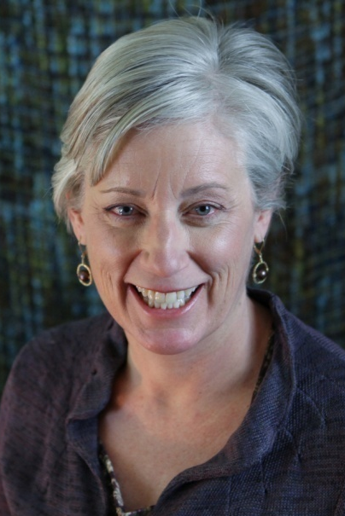
Your Presenter
Michele Lueck
President/CEO
Colorado Health Institute

Slide 4
Supreme Court Ruling on the ACA: Implications for Colorado
July 11, 2012

Slide 5
POLL: Where Were You on the Morning of June 28?
At my computer, following SCOTUSblog.
At my computer, following Twitter.
At my computer, following online news.
In front of a TV, watching the news.
At Snooze, eating pancakes.

Slide 6
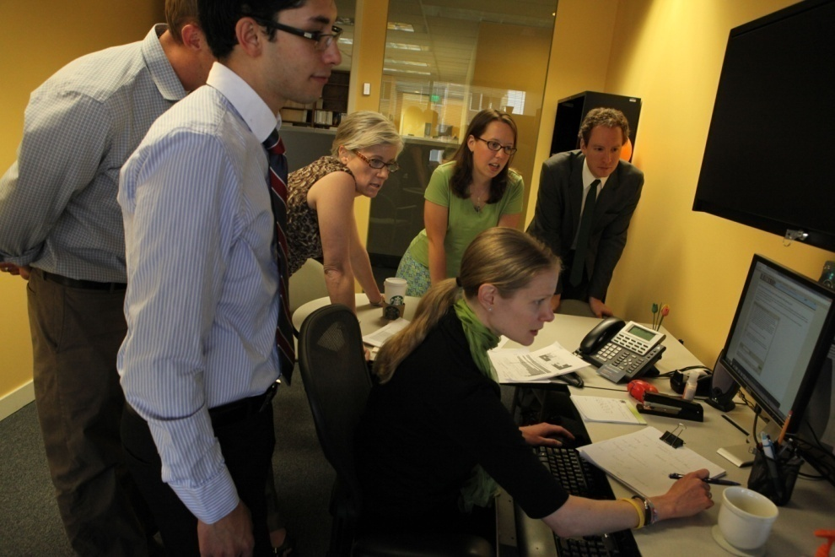
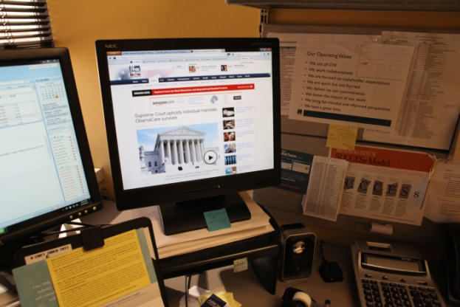
CHI on Decision Day 2012

Slide 7
POLL: How Close Were You to Correctly Calling the Ruling?
Nailed it. I just knew Roberts would be the key vote.
I had a hunch the mandate would stand.
Somewhat surprised.
Totally surprised. I thought the mandate would be ruled unconstitutional.

Slide 8
Today’s Discussion
Five Implications of the ACA Ruling
Will we choose to expand Medicaid?
Will the Exchange be ready?
What will our Essential Health Benefits include?
Can we drive behavior change?
Will implementation be smooth?

Slide 9
Three Take-Aways from Today
Implementation is now the focus of the ACA.
Implementation will be shaped by national and state policies, willingness and appetite.
Elections may trump legal issues.

Slide 10
#1: Will Colorado Choose to Expand Medicaid?

Slide 11
The Ruling
States may opt out of the Medicaid Expansion
Adults to 133% of FPL

Slide 12
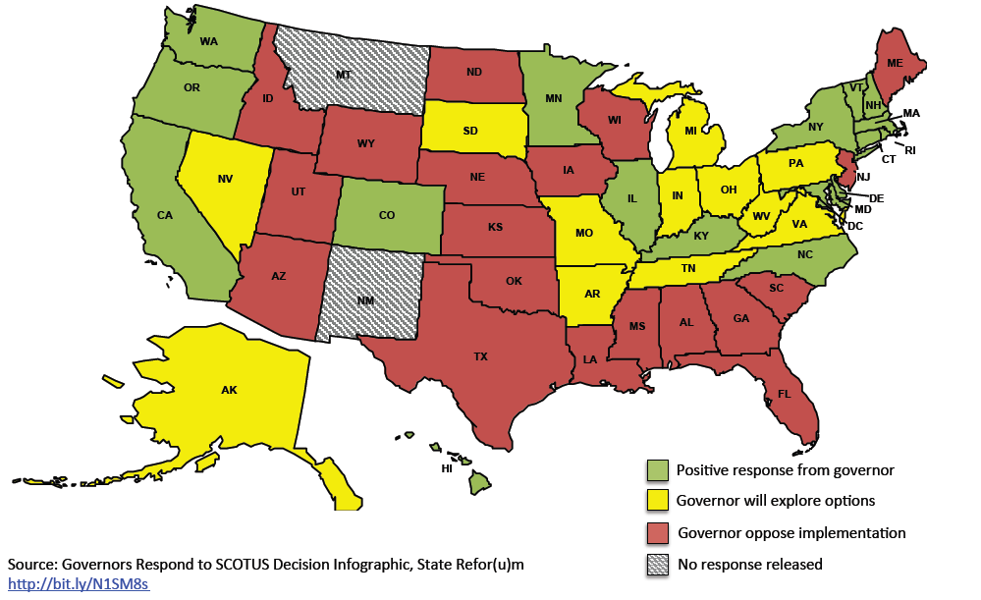
Early Reactions from Governors

Slide 13
The Finance Equation
Year | FMAP for newly eligible adults (up to 133% of FPL)
2014 | 100%
2015 | 100%
2016 | 100%
2017 | 95%
2018 | 94%
2019 | 93%
2020 and beyond | 90%
Source: Kaiser Family Foundation

Slide 14
How Much Will it Cost Colorado? Estimates Vary
$191 million
(2017-2020)
April 2010
HCPF is revising
Includes only general fund, not hospital provider fee

Slide 15
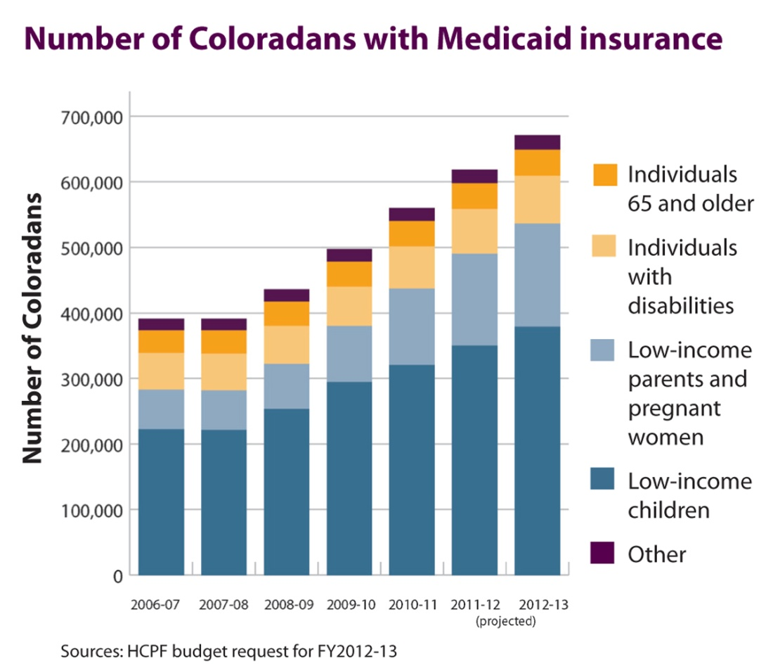
Medicaid Caseload Grows; Per-Capita Costs Flat
Medicaid Caseload, 2006-07 – 2012-13
Per-Capita Costs, 2006-07 – 2012-13
Source: JBC State Budget Briefing, HCPF, December 15, 2011

Slide 16
The CHI Take: Cautious Expansion Plans
Colorado’s history supporting Medicaid expansions.
Colorado Health Care Affordability Act
Who makes decisions?
“We remain committed to doing everything we can to improve the health and health care of all Coloradans.” – Gov. John Hickenlooper, 6/28/12

Slide 17
POLL: How Controversial will Colorado’s Decision Be?
No controversy
Just a little
I’ve seen worse
A few sparks will fly
Lots of controversy

Slide 18
#2: Will COHBE Be Open by October 2013?

Slide 19
The Ruling
Substantial federal funding is still available to build COHBE’s physical and technological infrastructure
Individual mandate = new customers

Slide 20
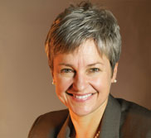
Colorado Context
“The Supreme Court ruling yesterday allows us to stay on track with the work of building a new health insurance marketplace for Colorado.” – Patty Fontneau, ED/CEO of COHBE

Slide 21
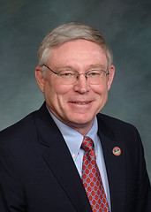
CHI Take: COHBE Goes Live On Time
Likely to open for business in 2013
Ready from the policy, technological, political perspectives
Watchful of elections
"I think that Colorado did the right thing by having a mechanism to do its best to impose a Colorado solution." – Rep. Bob Gardner (R), Chair, Legislative Oversight Committee, COHBE, June 28, 2012

Slide 22
#3: What will Colorado Include in Essential Health Benefits?

Slide 23
Vending Machines and Health Insurance
What will the vending machine look like and how will it work?
What’s in the vending machine?
How big will the items be?

Slide 24
What’s in the Law: 10 Broad Categories
Essential Health Benefit Required Categories
State Benchmark Plan
Ambulatory Services
Ambulatory Services
Ambulatory Services
Emergency Services
Emergency Services
Hospitalization
Hospitalization
Maternity and Newborn Care
Maternity and Newborn Care
Mental Health and Substance Abuse
Mental Health and Substance Abuse
Prescription Drugs
Prescription Drugs
Rehabilitation and Habilitative Services
Rehabilitation and Habilitative Services
Laboratory Services
Laboratory Services
Pediatric Oral and Vision
Preventive and Wellness Services
Preventive and Wellness Services
Pediatric Services
Pediatric Services Including Oral and Vision

Slide 25
CHI Take: A Decision Already Determined
One of the three largest small group plans
Kaiser, United, Anthem BCBS
One of the three largest state employee health plans
Kaiser, Kaiser, United
One of the three largest federal employee health plan options
BCBS, BCBS, GEHA
The largest HMO plan offered in the commercial market
Kaiser

Slide 26
Colorado’s Proposed Process
Compile information on benchmark options
Introductory webinar
Public meetings
Public comment period
Proposed recommendation
Future stakeholder engagement
SOURCE: Webinar presented by DORA, DOI, and COHBE on June 29, 2012

Slide 27
Our take: A Balancing Act Challenge
Comprehensiveness of services
Cost

Slide 28
#4: Will Tax Penalties be Sufficient to Change Behavior?

Slide 29
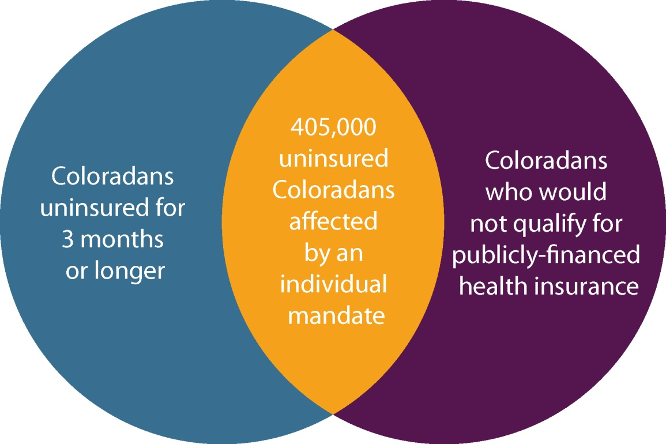
The Ruling
The Individual Mandate Stands
Source: 2011 Colorado Health Access Survey

Slide 30
The Question: Driving Behavior Change
Nearly 80% of the uninsured said they can afford to pay something for health coverage
Source: 2011 Colorado Health Access Survey

Slide 31
A Question of Willingness to Pay
20% of those “able” to pay are not “willing” to pay anything
10% are “able” and “willing” to pay only $1 to $25 a month
Of those who didn’t know how much they’d be willing to pay, 12% then said they couldn’t afford $50 a month
Source: 2011 Colorado Health Access Survey

Slide 32
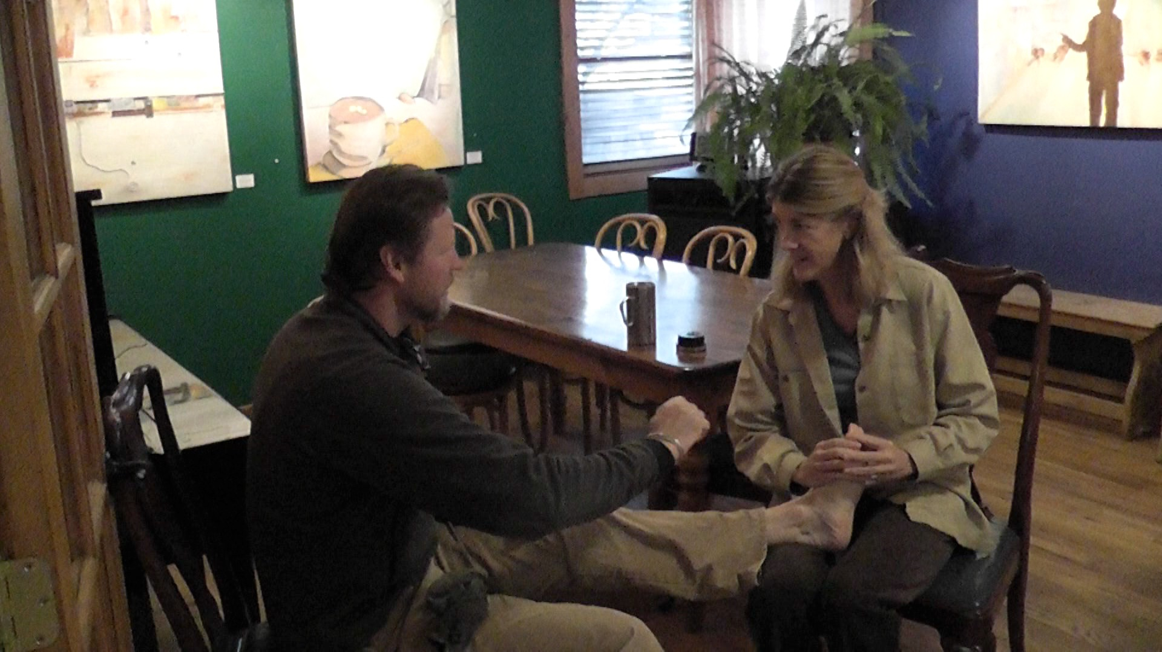
CHI Take: Driving Consumer Behavior is Hard

Slide 33
#5: Will the ACA Survive November Elections?

Slide 34
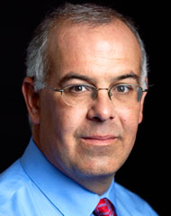
What’s Next
“Hospitals are changing rapidly. Federal policy will change rapidly, too. The policy changes over the next decade will overshadow Obamacare.
Roberts has made a period of innovation and change more likely. He did it by taking the court off center stage and by letting the political process play out.”
David Brooks – June 28, 2012

Slide 35
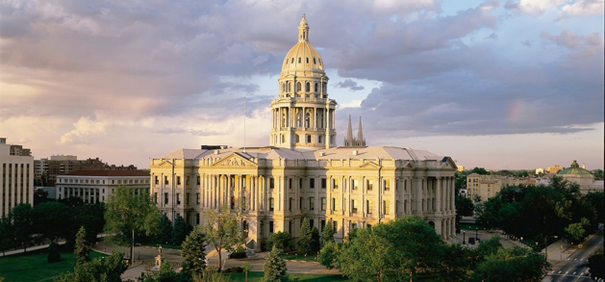
Colorado Context
At issue: National and state elections
Sequestration: $1.2 trillion in cuts starting in 2013
Medicaid: Exempt from cuts
Medicare: Up to 2% cut in payments to plans and providers

Slide 36
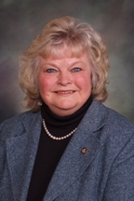
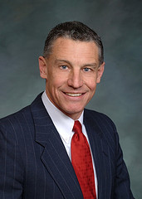
Leadership: Changing of the Guard
All 65 House seats and 20 Senate seats up for re-election in November.
Sen. Betty Boyd (D)
Chair, Health and Human Services Committee
Term-limited
Rep. Ken Summers (R)
Chair, Health and Environment Committee
Running for Senate

Slide 37
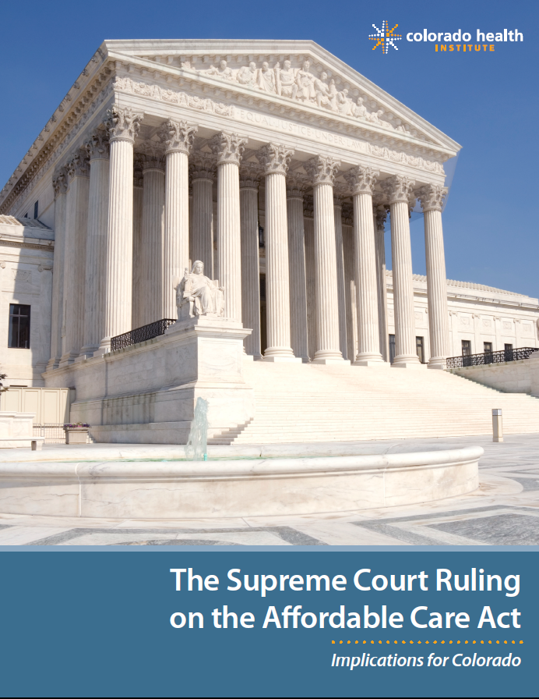
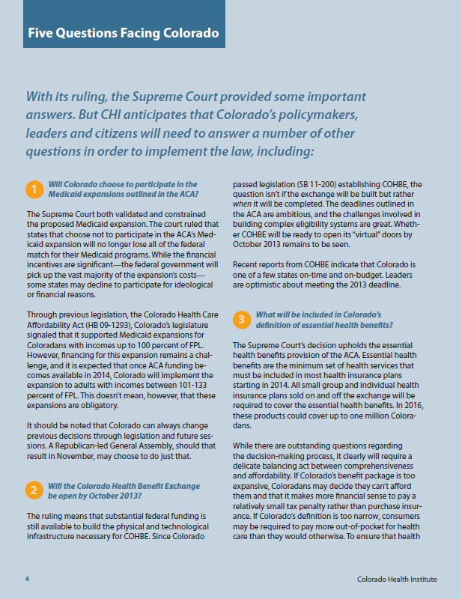
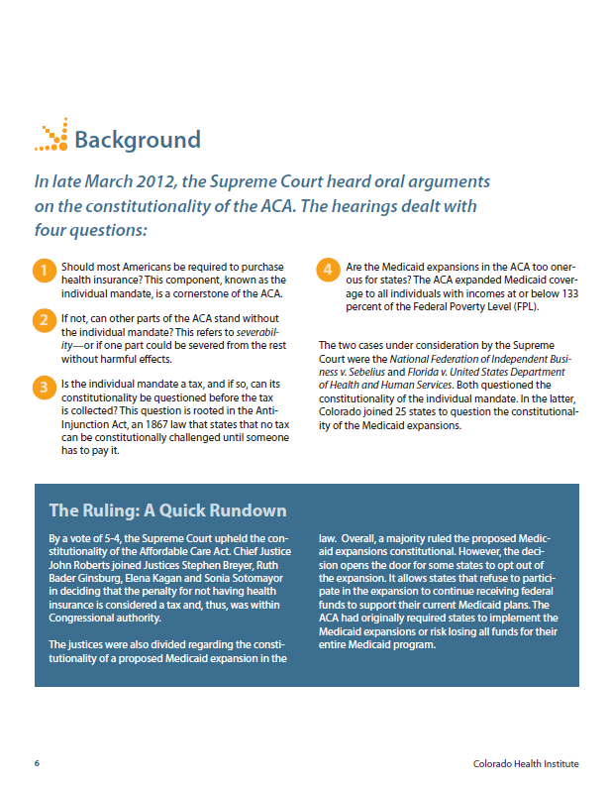
CHI Analysis: Companion Piece
Download it here:
http://bit.ly/N1Bokg

Slide 38
Source: http://www.colorado.gov/dpa/doit/archives/cch/home.htm
Colorado State Home for Dependent and Neglected Children
1898
Michele Lueck 720.382.7073 LueckM@coloradohealthinstitute.org

Slide 39
Upcoming Webinars
August 1 – Addressing the Boomer Challenge: Long-term Services and Supports
Check back in the fall for more webinars.
All webinars are at noon. Register here: bit.ly/KFIP0P

