Slide 1
Notes:
Thank you, Andrew. Like Andrew said, my name is Jalyn Ingalls and I am policy analyst at the Colorado Health Institute. In addition to other behavioral health projects, I have spent the past year facilitating and co-authoring the Road to Wellness: A strategic framework to improve behavioral health in Denver. I have had the pleasure of working with many people across the city and county of Denver to pull together diverse voices and perspectives that informed this framework.
I want to spend my time with you today to bring a national and state issue down to the local level. We know that communities across Colorado have taken upon themselves to raise money to support behavioral health. I want to highlight one example of how a community is building on the momentum to address this pressing issue.
And as I do that, I am going to bring us back to Michele’s opening remarks from yesterday, and highlight the role of expertise and lived experience to create a product and a system that impacts change.

Slide 2
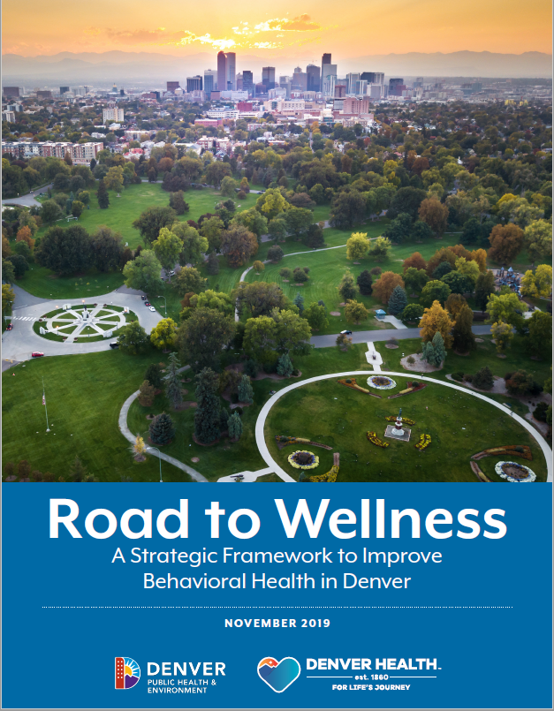
Mayor Hancock convened a Steering Committee of about 20 state and local experts
Aligned with other initiatives, including Caring 4 Denver
Notes:
I want to focus my time with you on the details of the framework, but there are two things you need to know as a level set.
[CLICK] First, In October 2018, Mayor Hancock pulled together a body of people to help focus efforts and align the work of many partners across the community. His goal was not to create all net new efforts, but to build off of existing work that is underway to create a coordinated approach for addressing behavioral health. The Mayor recognized that there was a lot of expertise in Denver that could inform this work, and he gathered state and local experts as a part of his behavioral health steering committee.
- and before I jump to my second point, I am curious: how many of you are from a community that has some sort of passed a behavioral health tax?
[CLICK] As we kicked off this project, momentum was growing to support and address behavioral health through Caring 4 Denver. This initiative estimated to bring in 45 million dollars to address mental health and substance misuse in the city, and successfully passed in November. Caring 4 Denver and the Steering Committee have recognized the need to align – and we anticipate that there will be opportunities for both groups to ensure these initiatives are moving in the same direction.

Slide 3
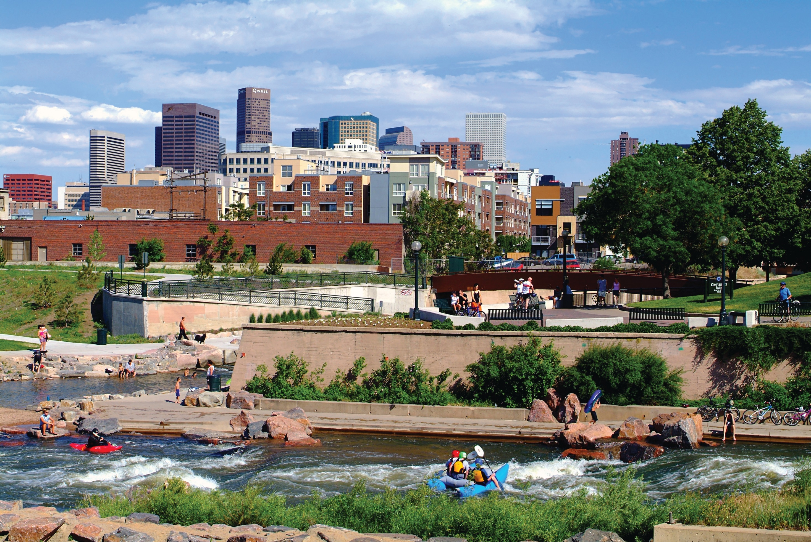
Behavioral Health Is …
a state of well-being in which every individual realizes his or her own potential, can cope with the normal stresses of life, can work productively and fruitfully, and is able to make a contribution to her or his community.
Notes:
Now that you have a high level overview of the work, let’s jump into the specifics. The first thing the Steering Committee did was define a common understanding of behavioral health by adopting the World health organization’s definition. I will give you a few minutes to read: PAUSE for 5. This definition takes a holistic approach, and additionally I want to highlight two values that the group set during this defining conversation.
Everyone experiences behavioral health – just like at some point or another we all experience physical health issues. It is helpful to think of behavioral health on a continuum
For example, on one end you have good or positive behavioral health. So for example, think about a time when you personally have experienced nature that is calming and relaxing, and maybe rejuvenated you. For me, this was enjoying time with family and playing basketball with my cousins over the holiday weekend.
And then we have stressful times – can you imagine a stressful work week? How about the last week of April 2019 for the state legislators in the room?
And then we have more severe behavioral health symptoms. This includes things like substance misuse and specific mental health conditions that require intensive services.
There are many of us in the room who know someone who is or has been addicted to substance and in need of intensive behavioral health treatment. We can imagine what this looks like.
Everyone has a role in addressing behavioral health. Behavioral health doesn’t happen some place else, it happens with everyone in our daily lives. Something that really resonated with me from Adam’s presentation yesterday evening is his hope that the services his sister received during her darkest days brought her some peace. This reminded me that the services and supports that people receive – that our systems and organizations work so hard to provide – are critically important.
This is how the Steering Committee has conceptualized and understands behavioral health.

Slide 4
Notes:
We created this image to help map the process of the work, and I want to walk through it together.
- Vision – here we bring in that we are focused on everyone, and not just those who have a specific mental health condition.
- [CLICK] The steering committee also identified these Core Beliefs, which are we believe we need to act early, that recovery is possible, we need to be culturally inclusive, be accountable, and be driven by community.
[CLICK] To accomplish this vision, the steering committee stood up four workgroups: community involvement and behavioral health literacy, promoting positive mental health, substance misuse, and behavioral health crisis response. In addition, we gathered input through community listening sessions across Denver.
As Michele mentioned – we need expertise combined with crowdsourcing- or personal and lived experience - and other layers of input to inform the system. As we tinker with it, it creates ripple effects across the system and we need people around the table who can speak from their experience to guide decision-making throughout the process. I am going to talk a bit more about that in a minute, but I was to ask:
AUDIENCE: How many of you were involved in this process at some level, or had a member of your organization participate?
- Transition to next slide

Slide 5
Bringing in Community Voices
Everything everybody has said is true. We know what to do, we just need to do something.”
Half the people I work with are desperately trying to find services…The other half are trying to get out [recovery]. There is a disconnect in the system – so many people desperately needing care while others desperately want out.”
You develop these behavioral health issues when you don’t have coping skills. I don’t think it hurts to help kids even as young as pre-K learn how to cope. I think some schools work on this, but I think that would go a long way.”
Notes:
..makes me excited to share with you the results of our report. As I mentioned previously, we brought in layers of insight to create this framework. When we listened to Denver residents, we heard things like: CLICK THROUGH QUOTES
The challenge we face – and our opportunity – is to blend these ideas and voices. We want to create harmony, and as Jay Want eloquently said yesterday, this is not by denigrating expertise, but by the democratization of expertise
And when we put this into action, the end result is that we can all reach our common goal of creating a better system.

Slide 6
Goals for Denver
1
Our communities promote well-being.
Notes:
And on that note, let’s jump into the 5 overarching goals the group identified – each with 6 to 8 specific recommendations for accomplishing the goal, and key metrics to monitor progress. These goals were crafted to create a space that captured work already underway, as well as space to advocate and push for more. If we accomplish these goals as a city, we will achieve our vision.
For Denver to experience good mental health:
- [CLICK] communities must promote well-being.
1. Advocate for policies that address social determinants of health. Think food insecurity; housing, paid family leave.
2. Move upstream to provide support services for families, like home visitation, affordable child care
3. This goal really focuses on preventing behavioral health concerns.
AUDIENCE: Who can tell me what social policy Denver City Council just voted on recently?
MINUMUM WAGE INCREASE.

Slide 7
Goals for Denver
1
Our communities promote well-being.
2
When we seek care, we get the care we need.
3
We have access to compassionate, integrated, coordinated care.
Notes:
Next, for Denver to experience well-being:
[CLICK] residents must get the care they need and get it in a compassionate, integrated, and coordinated way.
While there are many elements need to reach this, I want to point out the role of peers. Peer support specialists, a person with lived experience in recovery who supports others, can be used to help build relationships with people who need support. Often we think of providing peers once a person has already received treatment services, but peers can be used at many stages of care to meet people where they are at, engage with services and resources, and provide support throughout the process.

Slide 8
Goals for Denver
1
Our communities promote well-being.
2
When we seek care, we get the care we need.
3
We have access to compassionate, integrated, coordinated care.
4
We act early and manage crises in the appropriate setting.
Notes:
And for Denver to experience well-being:
[CLICK] our system must act early and manage crises in the appropriate setting.
This goal was primarily informed by the behavioral health crisis response workgroup, which brought together criminal justice, law enforcement, behavioral health providers, and first responders to discuss how we could better serve people in crisis. One of the approaches is to not just have behavioral health providers respond with law enforcement to crisis calls, but to create another arm of first response of just behavioral health providers who can access and respond to behavioral health crises with the appropriate services.

Slide 9
Goals for Denver
1
Our communities promote well-being.
2
When we seek care, we get the care we need.
3
We have access to compassionate, integrated, coordinated care.
4
We act early and manage crises in the appropriate setting.
5
We have the data to understand and improve behavioral health.
Notes:
And last but not least, for Denver to experience well-being:
- [CLICK] our system needs to have the data needed to understand and improve behavioral health.
This recommendation was informed by a continued conversation around SUD and the need to better understand what services are needed, and what services are available in order to get people the appropriate level of care.
But in addition to having the data to inform the workforce, consumers need the opportunity to understand release of information, consent, and their privacy rights when it come to data sharing.
I want to pause. That was a lot of information, and yet only scratched the surface on the details included in the framework. But I what I really want you to remember from this is that these are the 5 goals identified by many stakeholders across the city. And if we can achieve these things, all Denver residents will have an opportunity to experience good behavioral health

Slide 10
Steering Committee Member Rob Bremer, Vice President of Network Strategy, Colorado Access
Steering Committee Member Wes Williams, Vice President and Chief Information Officer, Mental Health Center of Denver
Notes:
Today, we have the honor of having two of our Steering Committee members in the audience to share insights from the group that guided this work . Rob Bremer is the Vice President of Network Strategy at Colorado Access, and Wes Williams is the Vice President and CIO at Mental Health Center of Denver.
I have asked Rob and Wes to join me on stage today to answer a few questions about his experience – and leave you with the inside scoop to the production of the Road to Wellness Framework.
Rob - thanks for joining us.
I have talked a bit about the values we established as a group from the very beginning of the process. Tell us about your experience on the Steering Committee, and the role that values played in defining the direction of the Strategic Framework.
2. Can you share any lessons learned or insights for other communities considering this work?
3. One of the things we heard from participants is that we often know what to do to support people’s behavioral health, and that we just need to take action. What are your hopes for this framework moving forward – in your role at Colorado Access and MHCD?
The Mayor will be formally releasing this document in the next 4 to 6 week. As Michele comes up to close us out, I would like to offer her the opportunity to share her insights as well.

