Slide 1
Colorado Updates: 2011 Health Report Card & Payment Reform
April 4, 2012
Colorado AHEC Series

Slide 2
Today’s Discussion
2011 Colorado Health Report Card
Payment Reform in Colorado

Slide 3
The 2011 Colorado Health Report Card

Slide 4
Methodology
2011 Report Card includes 38 indicators grouped into 5 life stages
Grades are based on Colorado’s ranking among states using most recent data available
Healthy
Beginnings
Healthy
Children
Healthy
Adolescents
Healthy
Adults
Healthy
Aging
A B C D F
Top 10
states
Bottom 10
states

Slide 5
What We Measure
Prenatal care and healthy babies
Vaccinations
Insurance status
Primary, preventive, oral health
Exercise and obesity
Poverty rates
Smoking and sex
Chronic disease

Slide 6
Middle of the Pack

Slide 7
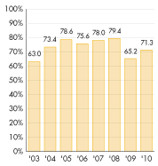
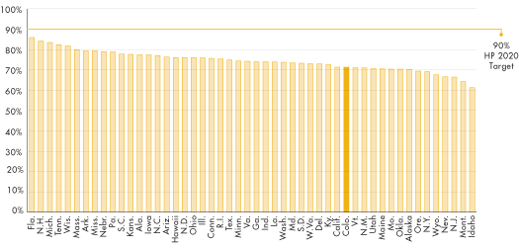
Highlight #1: Immunizations
Colorado, 2003-2010
Nation, 2010

Slide 8
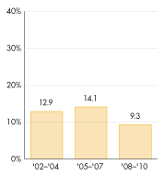
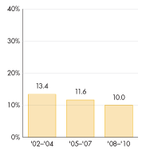
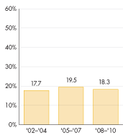
Highlight #2: Uninsured Kids
Children (ages 0-12)
Adolescents (ages 13-17)
Adults (ages 18-64)

Slide 9
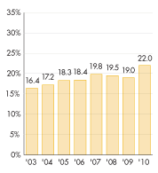
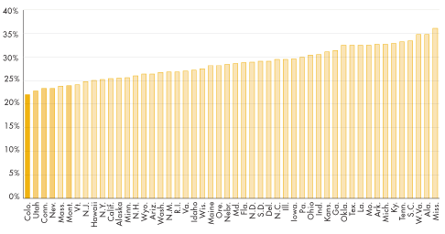
Highlight #3: Adult Obesity

Slide 10
Prevention: Strong Investments in Colorado’s Health

Slide 11
The Case for Prevention Investment
Program | Investment | Savings
Childhood vaccinations | $1 | $16
Nurse-Family Partnership | $1 | $1.26 to $5.70
Fluoridation | $1 | $38
Kids Preventative Dental | Visit before age 1 | $284
Tobacco Cessation | $1 | $10 to $59
Workplace Wellness | $1 | $3.27

Slide 12
www.ColoradoHealthReportCard.org

Slide 13
On the Front Lines of Payment Reform

Slide 14
Payment Reform Initiatives in Colorado

Slide 15
Goal of Payment Reform: The Triple Aim

Slide 16
Health Care Expenditures Comprise a Growing Sharing of Our Economy

Slide 17
Emphasis on Care Coordination

Slide 18
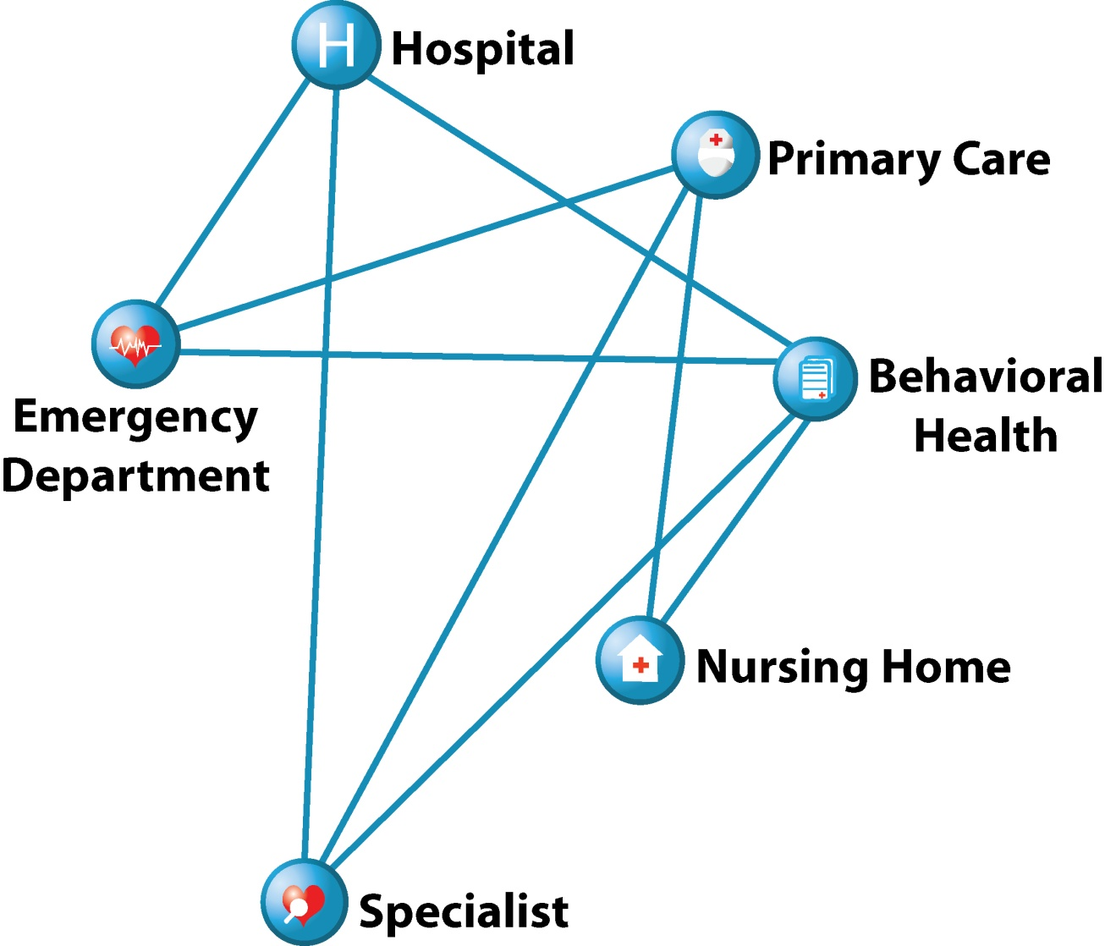
The Current Delivery System is Fragmented
Primary care providers may be unaware their patient has been to the hospital.
Patients may be subjected to unnecessary, repetitive tests.
A Dartmouth Institute study suggests 30 percent of care is unnecessary.¹
¹ The Dartmouth Institute, “Reflections on Geographic Variations in U.S. Health Care”, 2010.

Slide 19
Medical Homes
Multidisciplinary Care Team
Coordinated care across providers and specialties
Patient
Emphasis on prevention primary care education

Slide 20
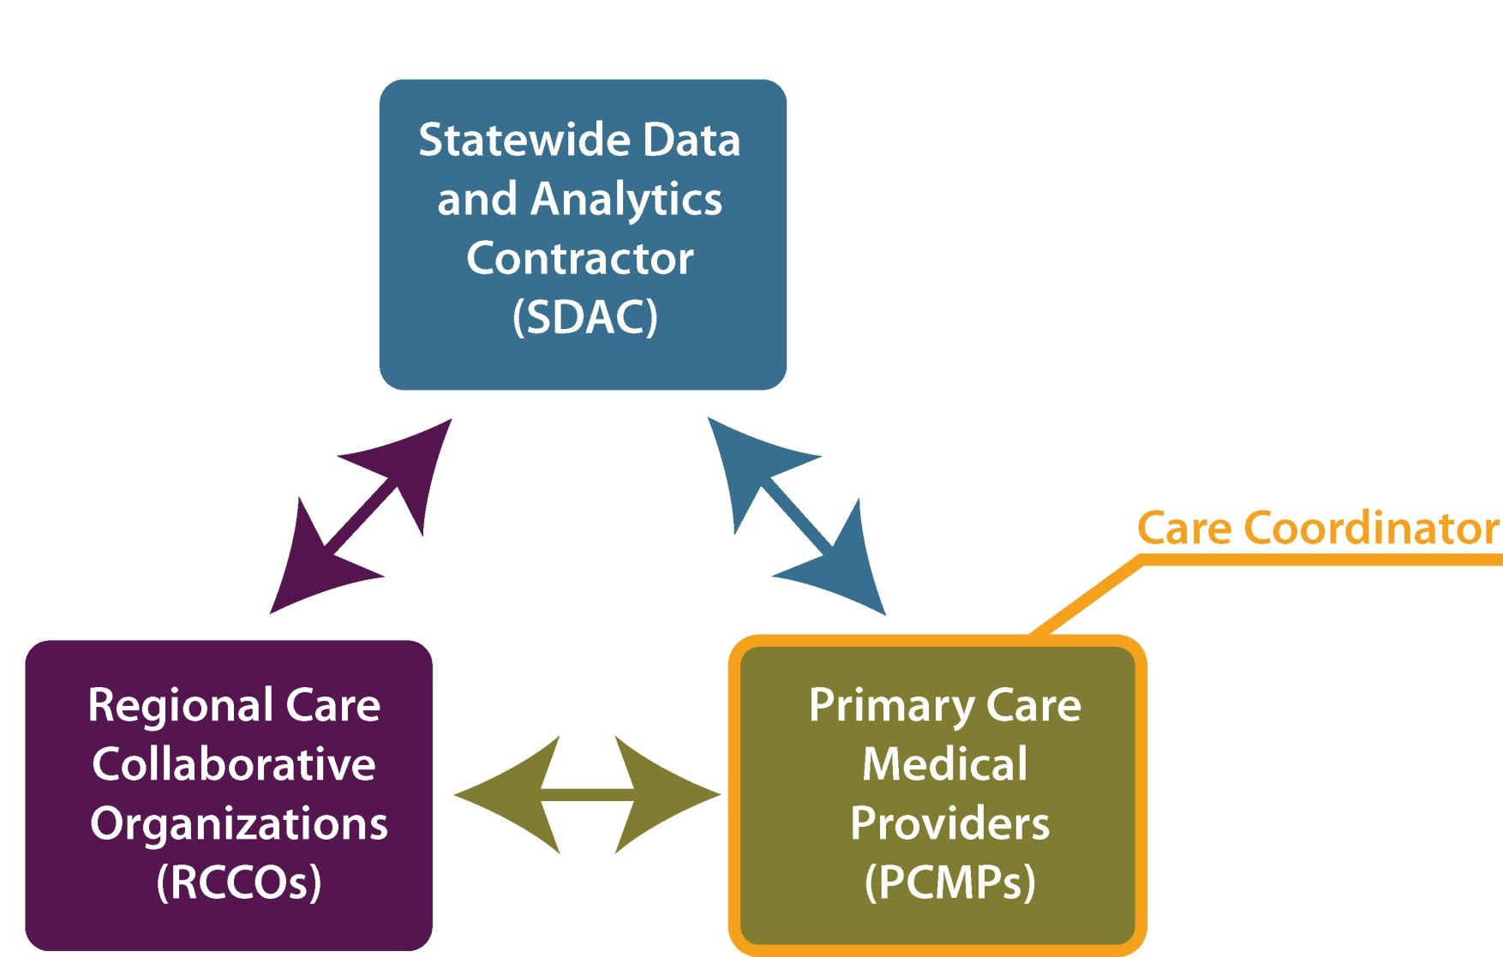
Medicaid Accountable Care Collaborative

Slide 21
The Good News on Medical Homes
Multidisciplinary Care Team
Coordinated care across providers and specialties
Patient
Emphasis on prevention primary care education

Slide 22
Payment Shifting from Volume to Value

Slide 23
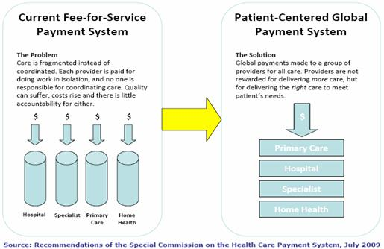
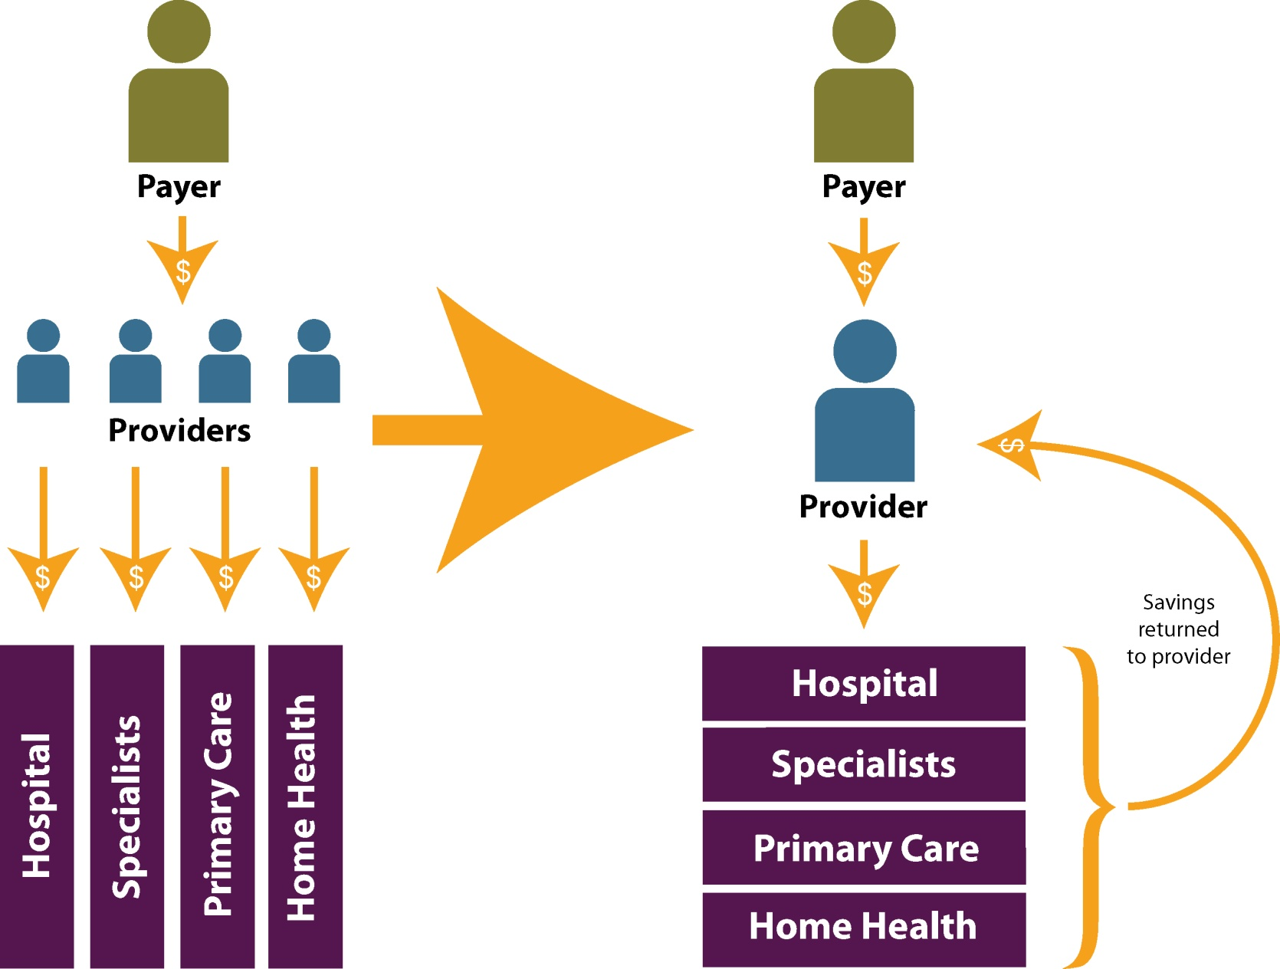
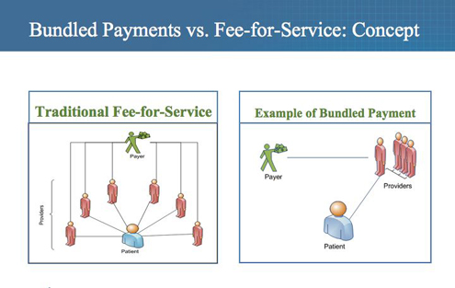
Payment Reform: Moving From Volume to Value

Slide 24
Bundled & Global Payments
What is Bundled Payment?
Fixed amount to providers for a specific episode of care
What is Global Payment?
Single, risk-adjusted payment to a responsible provider for patient’s care over fixed period of time

Slide 25
Role of Data and Information

Slide 26
“Hot Spotters”

Slide 27
On the HIT Horizon
HIT Horizon
Health Information Exchange
All Payer Claims Database
Meaningful Use

Slide 28
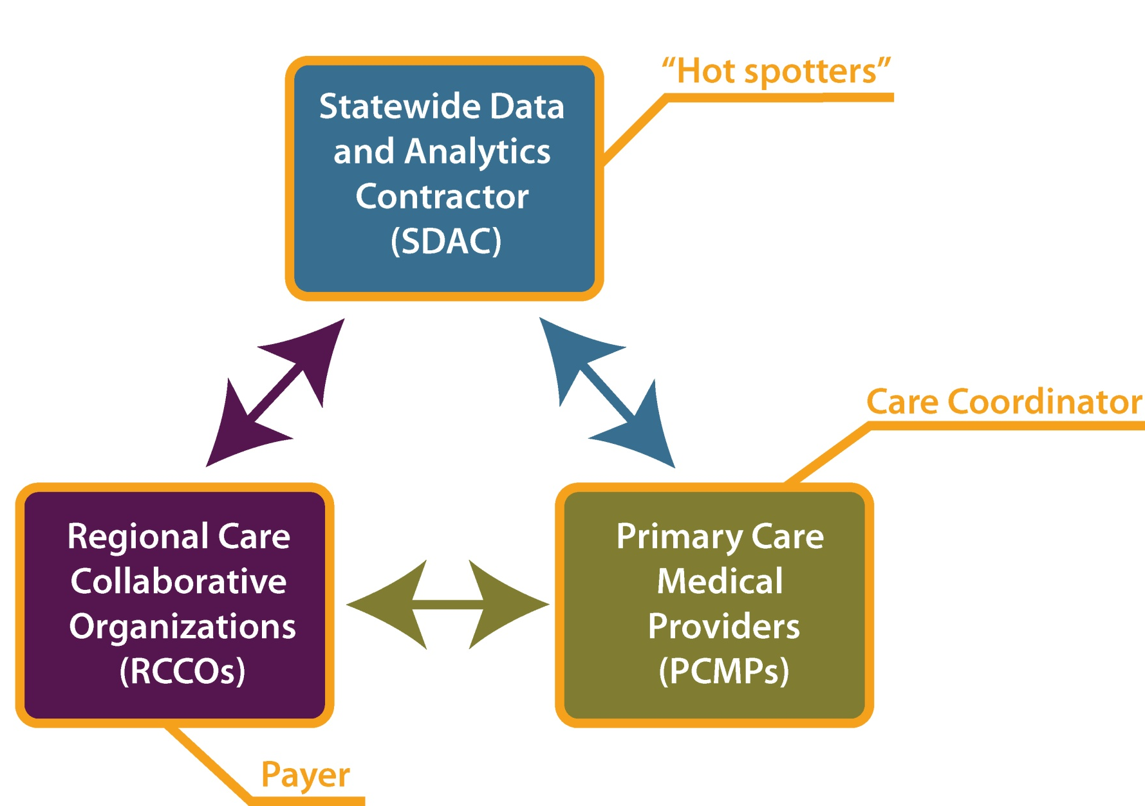
Medicaid Accountable Care Collaborative

Slide 29
Sara Schmitt 720.382.7081 schmitts@coloradohealthinstitute.org

