Slide 2
Our Plan for the Hour
Election review: Colorado’s evolving political geography
Parties and their changing coalitions: A panel discussion with Steve House and Ian Silverii
Notes:
This is a health policy conference. Why are we talking politics? It’s because you’ve got to engage in politics in order to make policy. And to engage in politics, you have to understand who you are engaging with. So we’re going to start with an election review, focusing on Colorado’s political geography. In a lot of ways, the ground is shifting beneath our feet.
There are different ways of looking at Colorado politics, and not all are especially useful or current. We’re going to dive deeper into these themes in our panel discussion with two of the state’s leading political strategists. Steve House, chairman of the Colorado Republican Party, and Ian Silverii, executive director of ProgressNow, an influential group on the left.

Slide 3
Three Themes
The Typical Ways of Looking at Colorado Voters are Outdated.
Education and Rural Residency Played a Large Role in the Results.
Ballot Issues Show the Parties are Not in Sync with Their Voters.

Slide 4
Ways of Looking at Colorado
Notes:
Here’s the map showing national presidential election results. But is Colorado really a blue state? That makes it sound far more liberal than it is (clear when you look broadly at how Coloradans voted).
Or is it a purple state? Colorado as a whole is certainly purple, but that misses many local-level differences and partisan splits.
Let’s look deeper inside Colorado’s political geography…

Slide 5
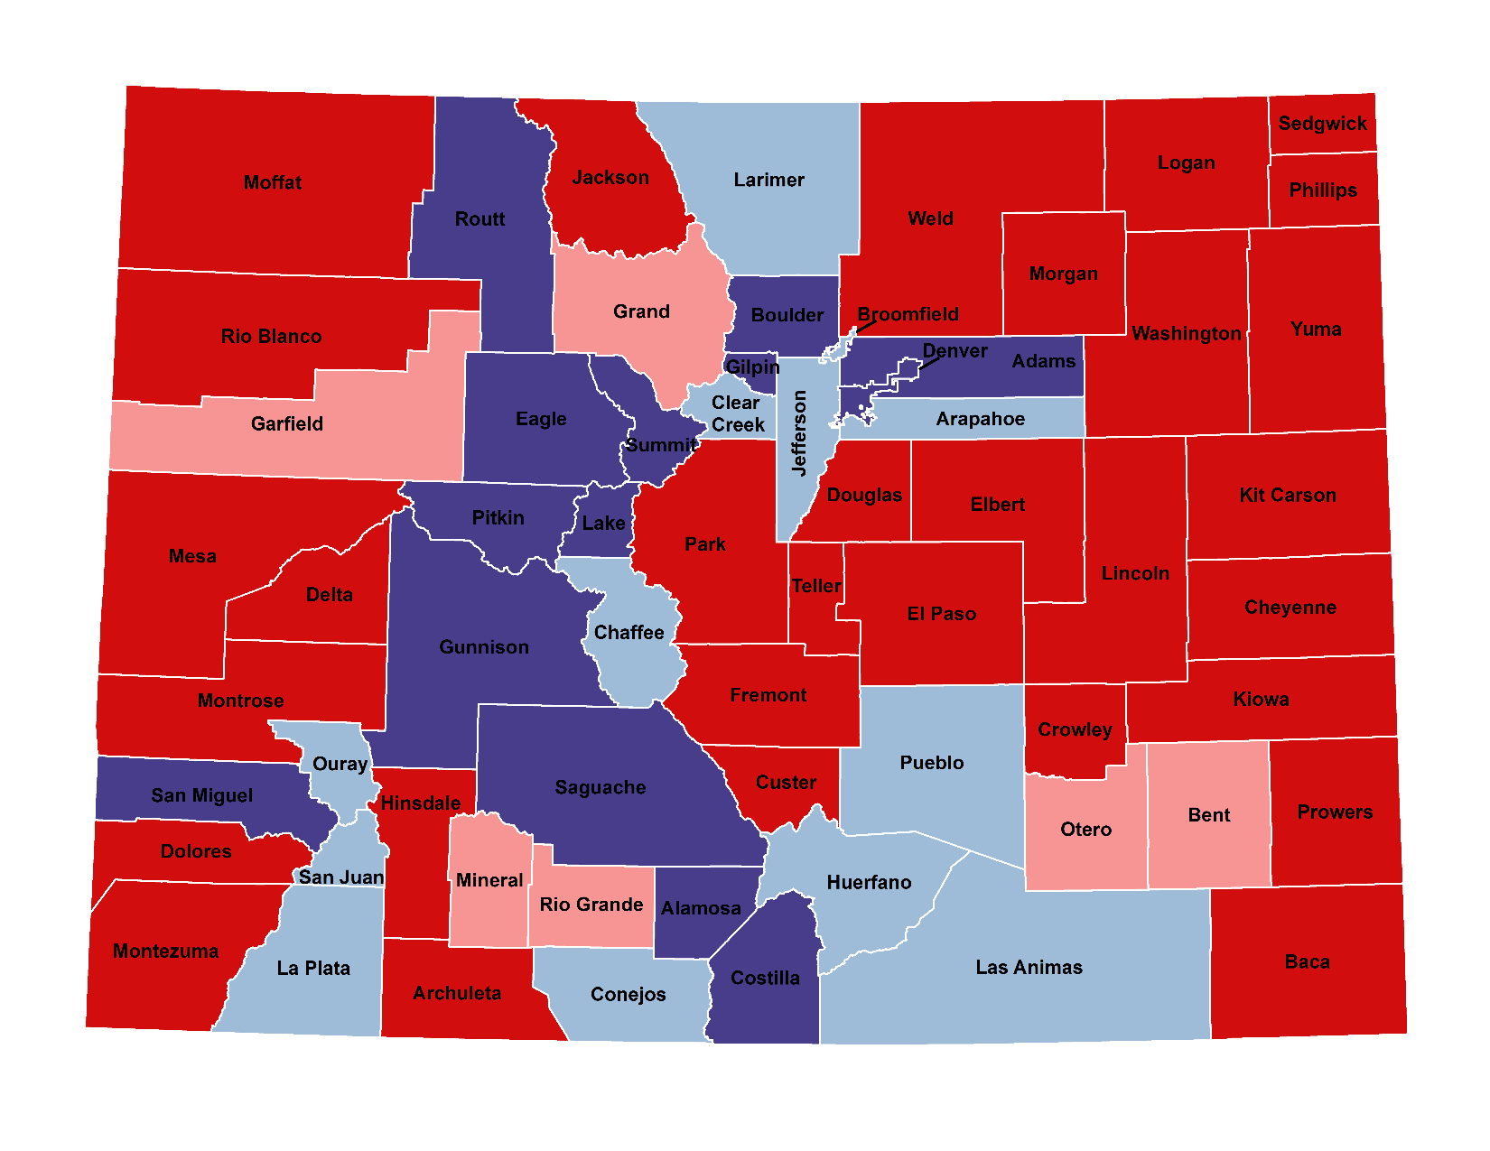
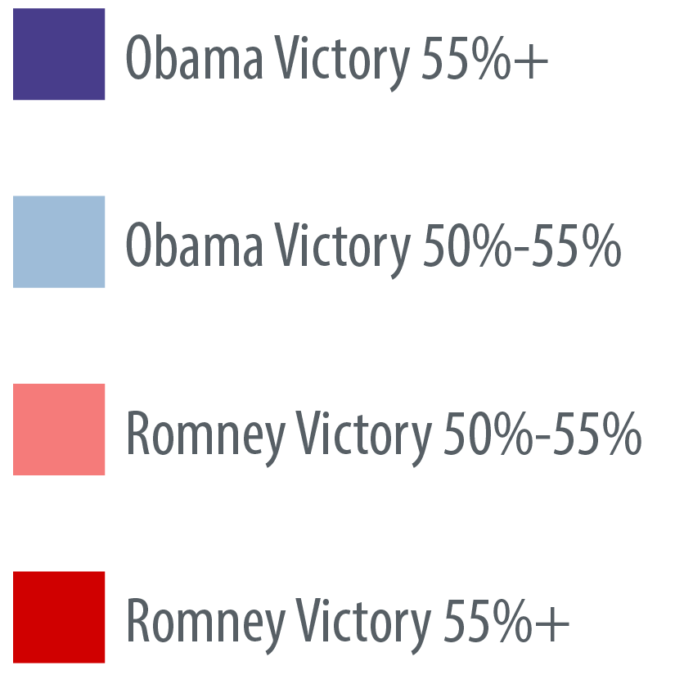
2012: The Way We Were
Notes:
Results and implications – This is the typical “C” shape of Democratic control, from North Central CO and Denver Metro down spine of the Rockies and over to Pueblo.

Slide 6
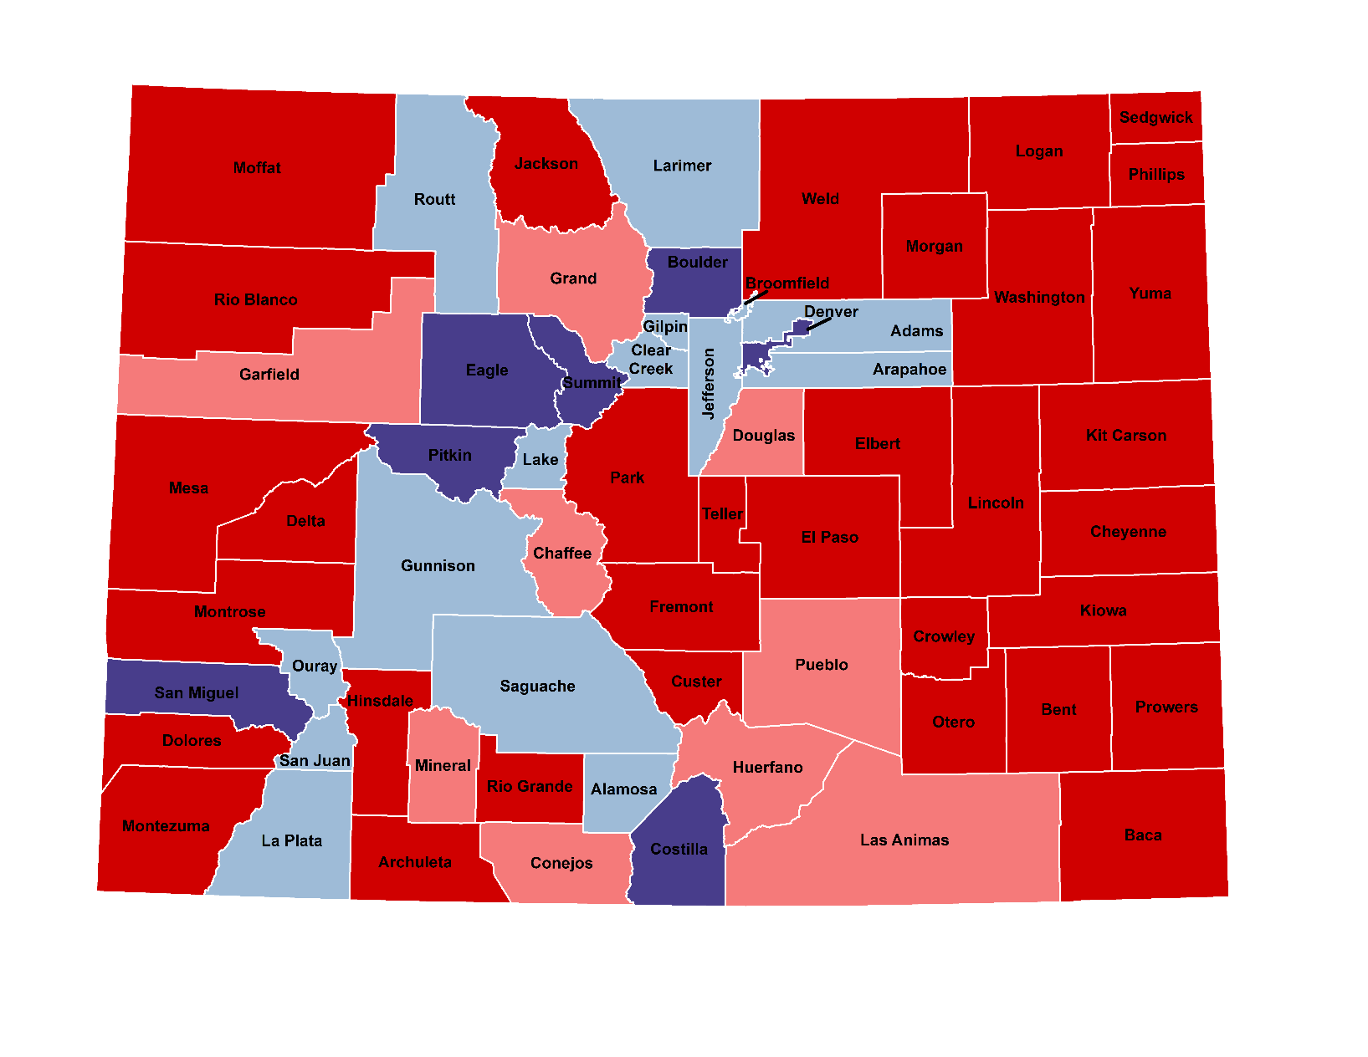
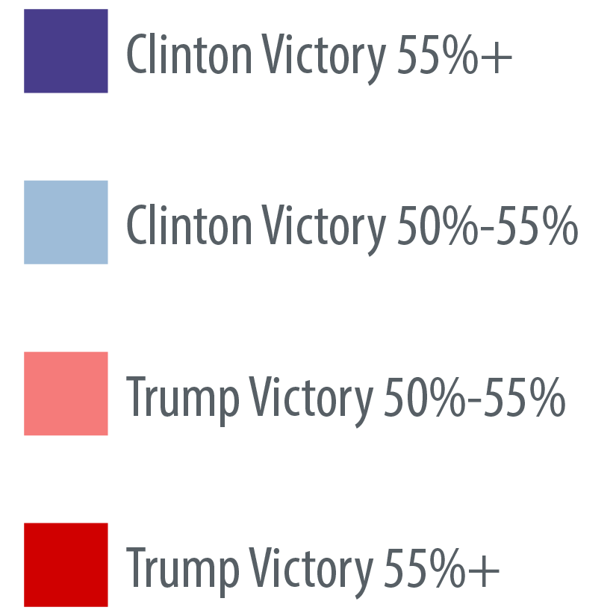
2016: A Blue River in a Sea of Red
Notes:
Trump and Clinton scrambled that map. Pueblo went for Trump by a few hundred votes, which surprised a lot of people, and he won other traditionally Democratic areas in southern CO. Many counties still went for Clinton, but did so with less enthusiasm.

Slide 7
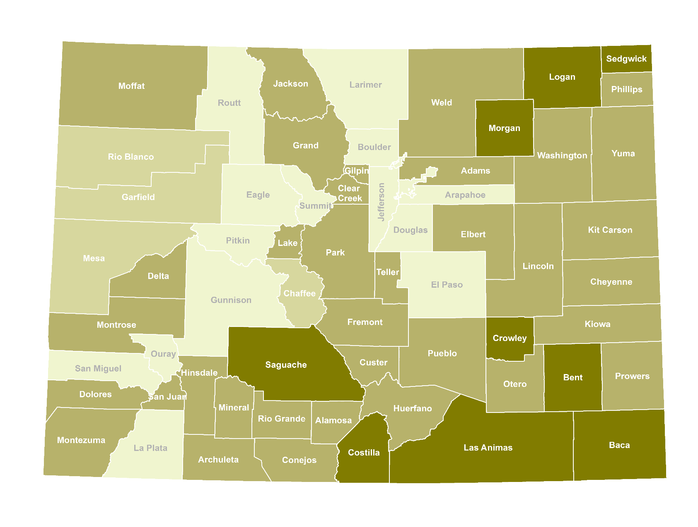
2016: Shifting Power Bases
10.2%
Notes:
Here’s a map you need to look at carefully, because I suspect you haven’t seen anything exactly like it before. This doesn’t show who won each county. Instead, it shows how Donald Trump’s share of the vote in each county differed from Mitt Romney’s share in 2012. The darker the green, the better Trump did compared with Romney. The lighter the green, the more he lost compared with 2012.
President-elect Trump redrew the U.S. political map. In Colorado, it’s easy to think that not much changed on the red-blue map. But underneath, the ground is shifting.
Trump performed better than Romney in most rural counties, except for resort counties. He even beat Romney’s share in the heavily Hispanic San Luis Valley. He also did better than Romney in “Colorado’s Ohio” — the blue-collar Democratic counties of Adams and Pueblo. Where did Trump do worst compared with Romney?

Slide 8
2016: Shifting Power Bases
Notes:
Douglas County. He ended up more than 8 points below Romney’s share in this Republican stronghold – one of the worst performances for Trump relative to Romney among Colorado counties. Trump also did worse than Romney in El Paso and Denver. Ski country and the suburban battlegrounds of Jefferson and Arapahoe.
What do all these counties have in common? They differ on their politics, but they’re urban, educated and have comparatively high average incomes.
Where did Trump make improvements?

Slide 9
2016: Shifting Power Bases
Notes:
This is another interesting county: Costilla, right on the New Mexico border, is where Trump made one of his biggest gains compared with Romney.
It’s two-thirds Hispanic. Trump didn’t come close to winning it, but he showed a huge improvement over Romney’s numbers from 2012 – more than an 8-point improvement.

Slide 10
2016: Shifting Power Bases
10.2%
Notes:
Let’s go back to this first map. It’s essentially a map of non-resort, rural Colorado, plus the “Rocky Mountain Rust Belt”: Pueblo and Adams counties.
This is not a Left-Right / Blue-Red / Democrat-Republican map, in the way we usually think of it. The divides here are within parties and across parties. It’s more accurate to say that it’s an urban-rural map – but even that is an oversimplification.
This is also a map that matches up fairly well with a map of education levels.

Slide 11
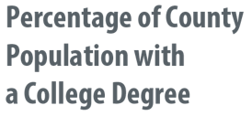
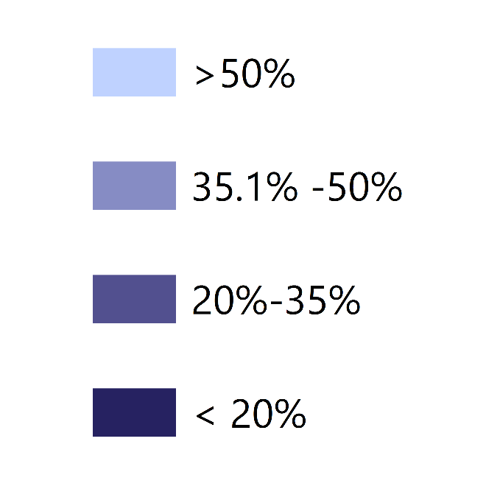
2016: Shifting Power Bases
Notes:
This shows the percentage of county residents with a four-year college degree, with the lighter the blue, the more people with degrees. You can see that many of the areas where Trump made up ground on Romney are less educated on average.

Slide 12
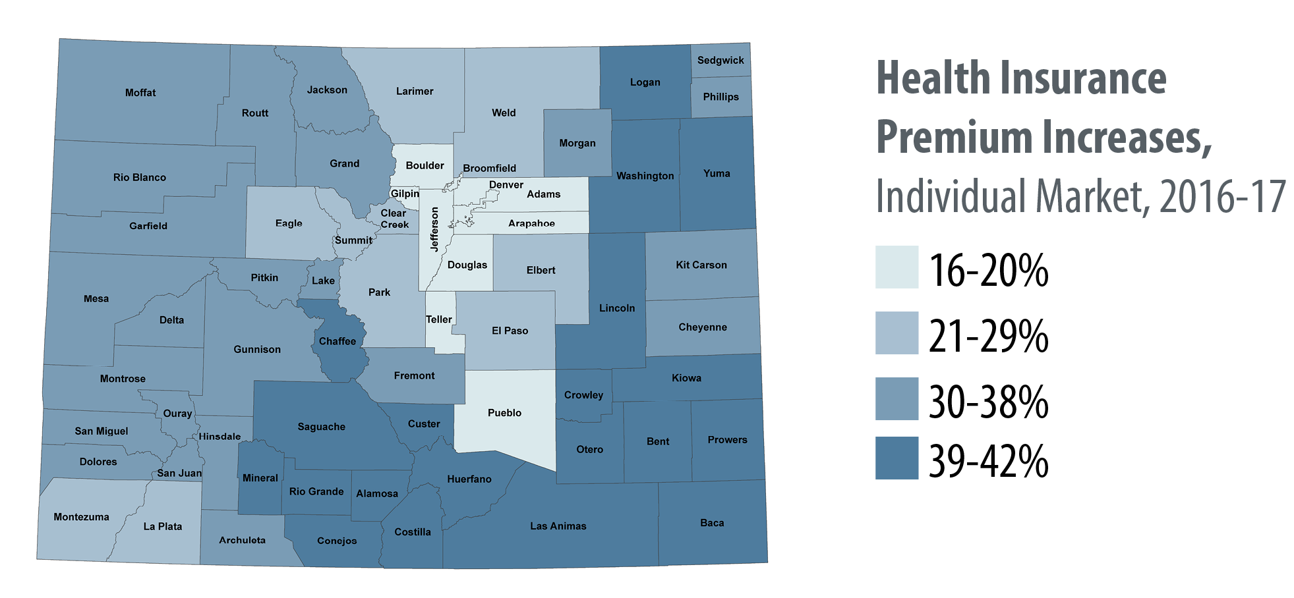
Look Familiar?
Notes:
This shows where individual market insurance premiums are increasing the most in 2017. It’s basically a map of rural Colorado. It’s also basically a map of where Trump did best — setting aside ski country and Colorado’s Ohio (again, that refers to blue-collar counties like Adams and Pueblo).
We’re not saying that Trump surged here because insurance prices are so high. But we are saying that people in rural Colorado face a different set of challenges, and they have felt for a long time like they’ve been ignored by Colorado’s highly urban population.
The Trump map also looks like this one…

Slide 13
Look Familiar?
Notes:
These maps show all drug overdoses (opioids and other causes). We abbreviated the legend here on the right – these are the highest and lowest categories of overdose deaths per 100,000 people. There are 11 shades of color on the map. The darker the red, the higher the overdose rate. Note that we are missing data for Mineral County.
The point? People often think of drugs as a core city problem. But in the past few years, we’ve come to recognize it as much – and more – as a rural problem.
Are we saying that insurance prices and drugs, especially opioids, led to Trump gains? No. What we are saying, again, is that the issues in rural Colorado are different from what those of us in urban areas face. And because rural people tend to feel more ignored by the system, they are thus more disposed to overthrowing it than people in urban areas, who are doing better in this economy.

Slide 14
None of the Above Share of Colorado Vote, 2012 and 2016
Notes:
Reminder: There’s a large group of voters who weren’t buying what either party was selling this year. Many people voted across party lines (or didn’t even choose a presidential candidate on their ballot), and many Coloradans sent a clear message through their actions that they were dissatisfied with their choices.

Slide 15
Notes:
What else did Colorado voters say this year? They approved a rise in the minimum wage. Note that this map roughly follows the Clinton victory map, but a lot more rural counties voted in favor of minimum wage than they did for Clinton.
In other words, there were thousands of Coloradans who voted for Donald Trump AND for a minimum wage increase, even though GOP orthodoxy and Trump himself oppose mandated hikes in the minimum wage.
The takeaway is that the party platforms aren’t particularly in sync with where voters are.

Slide 16
Notes:
You could say the same thing about the tobacco tax. It passed only in Denver, Boulder and that swath of resort counties that cuts down the backbone of the Rocky Mountains – which is core Clinton country.
But this tax failed in a lot of counties that she carried, namely the Denver suburbs. This initiative was a pretty good example of liberal policy – use the taxing power of the state to discourage an unhealthy activity and subsidize healthy activities. And yet many Coloradans voted for Clinton but against the tobacco tax.
(I’ll grant you that $17 million in opposition ads from Phillip Morris probably played a big role in this race, as well.)

Slide 17
Notes:
And voters also approved Medical Aid in Dying. It was popular everywhere except the Eastern edge of the Plains and in Conejos County, receiving support from both Clinton and Trump counties.
So what were voters saying through these ballot initiatives? At first, it looks a little contradictory. Minimum wage increases are popular on the left. So are tobacco taxes. One passed, one didn’t. Aid in Dying faced religious opposition, yet it passed in El Paso County, the cradle of conservative Christianity for the whole country.
What’s going on? Maybe, these results are consistent. Colorado voters don’t like taxes. They voted down Amendments 69 and 72. They want a raise, and they want to be left alone to make their own personal decisions. So Amendment 70 and Proposition 106 passed. From a business owner’s perspective, a minimum wage hike is government intrusion. But most voters don’t own businesses, and from their perspective, higher wages mean more individual power. This also confirms what we’ve known about Colorado voters for a long time – that they are independent thinkers who often vote across party lines and are not tied to following a platform.
That’s my theory. I’d like to gut check it with you all and with our two expert panelists.

Slide 18
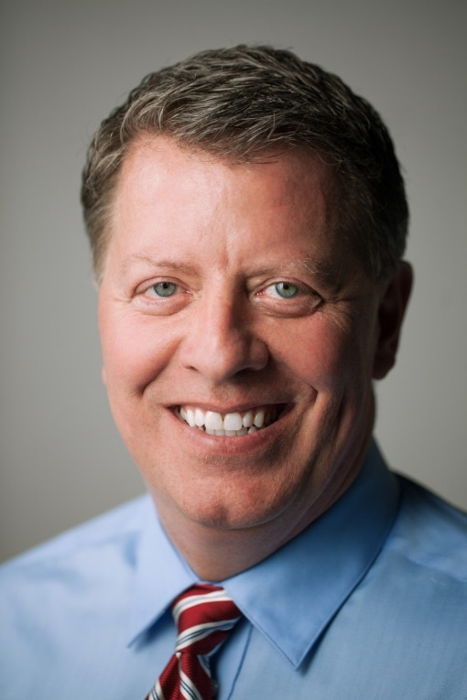
Our Panelists
Steve House
Chairman,
Colorado Republican Party
Ian Silverii
Executive Director,
Progress Now Colorado
Notes:
Steve House
Steve House became the Chairman of the Colorado Republican Party in March 2015. Prior to that, he spent 35 years in health care, working initially as an engineer in the early days of CT Scanners and MRI systems. He has owned his own business, worked as a leadership consult for health care companies across the U.S. and served as Director of Innovation for a technology division of Aetna. He was most recently involved in health care as a Director of Data and Analytics for the Colorado Region. House grew up on a small dairy farm in Michigan. He and his wife Donna have six children and three grandsons.
Ian Silverii
Ian Silverii began his career in Colorado politics in 2008 as a legislative aide in the Colorado House of Representatives after graduating from Rutgers University in New Jersey. Since then, Silverii has worked on dozens of successful campaigns at the Colorado House Majority Project, rising to Executive Director for the 2014 election cycle. Ian also has served the Colorado House Democratic caucus since 2010 in a variety of press and policy roles, including as Media Director, Legislative Director and finally as Chief of Staff to Speaker Dickey Lee Hullinghorst during the 70th General Assembly. Silverii is an avid reader, a terrible guitar player and an aspiring skier.

Slide 19
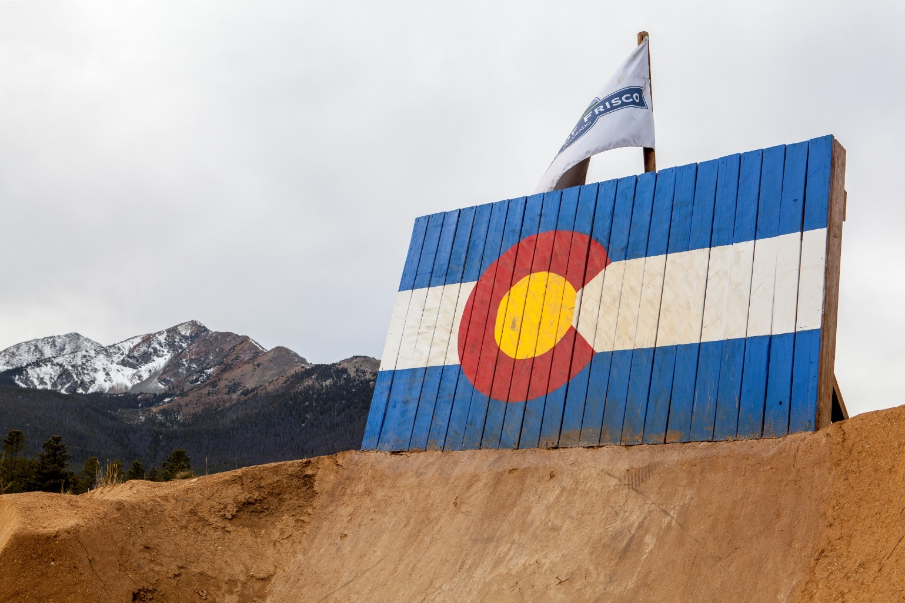
Joe Hanel
hanelj@coloradohealthinstitute.org

