Slide 1
Reining in Growth of Health Spending
February 16, 2012
2012 Health Policy Roundtables

Slide 2
Questions We Will Be Answering Today
What are the health care cost growth trends in Colorado and why do they matter?
What are the drivers?
How do we move from an idea to scaled implementation?
What’s happening in Colorado?
What are the results?
What do we still need to learn?

Slide 3
An Introduction (or Re-introduction) to the Colorado Health Institute
CHI serves as an independent and impartial source of reliable and relevant health information. CHI provides:
Presentations, roundtables, facilitation
Succinct or in-depth publications
Custom research
Evaluative services
No spin, just the facts

Slide 4
Trends and Why They Matter

Slide 5
Health Care Expenditures Comprise a Growing Sharing of Our Economy

Slide 6
Colorado Employee-only Health Insurance Premiums
SOURCE: Medical Expenditure Panel Survey

Slide 7
Colorado Family Health Insurance Premiums

Slide 8
Health Insurance Premiums Compared to Other Economic Indicators

Slide 9
A Decline in Coloradans’ Insurance Coverage
15.8%
57.8%
SOURCE: Colorado Health Access Survey, The Colorado Trust, 2011

Slide 10
Top Three Reasons Why Uninsured Coloradans Lacked Coverage
Reasons reported | 2011
Cost of health insurance is too high | 84.6%
Employed family member was not offered or eligible for employer’s coverage | 40.6%
Employed family member lost job or changed employers | 39.3%
SOURCE: Colorado Health Access Survey, The Colorado Trust, 2011
NOTE: Uninsured individuals could report more than one reason for being uninsured.

Slide 11
Drivers of Health Care Spending

Slide 12
Why are Health Care Costs Increasing in US?
System incentivizes volume
Insurance drives utilization of services
Higher income countries can afford more expensive health care services
Aging of the population, increase in disease prevalence
Inefficiencies in medical care delivery
SOURCE: Health Care Costs: Key Information on Health Care Costs and their Impact, Kaiser Family Foundation, 2009

Slide 13
The Skewing of Health Expenditures

Slide 14
Age is an Important Correlate with Cost
Annual Cost Per Capita

Slide 15
Medicaid Enrollees and Expenditures
SOURCE: Colorado Department of Health Care Policy and Financing, Executive Budget Request, Nov. 1, 2011. Rounding results in a total of more than 100 percent.

Slide 16
Medicaid Expenditures by Service Categories
SOURCE: Joint Budget Committee, FY2012-13 Staff Budget Briefing, Dec. 15, 2011

Slide 17
“Hot Spotters”

Slide 18
What Can We Do To Address Cost Drivers?

Slide 19
Continuum of Evidence: From Research to Program Implementation

Slide 20
Various Ways to Test Cost Savings
Medical homes and care coordination
Medicaid Accountable Care Collaborative
Accountable care organizations
Bundled payments
Global capitation

Slide 21
Medical Homes
Multidisciplinary Care Team
Coordinated care across providers and specialties
Patient
Emphasis on prevention primary care education

Slide 22
Colorado Medical Home Efforts
Medical Home Initiative for Children
Medicaid and CHP+
Multi-payer, Multi-state Patient Centered Medical Home Initiative
Medicaid, CoverColorado and five private payers
Safety Net Medical Home Initiative Demonstration
Fourteen safety net clinics

Slide 23
Medical Home: Impact on Controlling Costs
CMHI demonstrates savings but targeted to lower-cost populations
Colorado programs still being evaluated, early returns and national results encouraging
Complex, lengthy, resource-intense process for practices to become medical homes

Slide 24
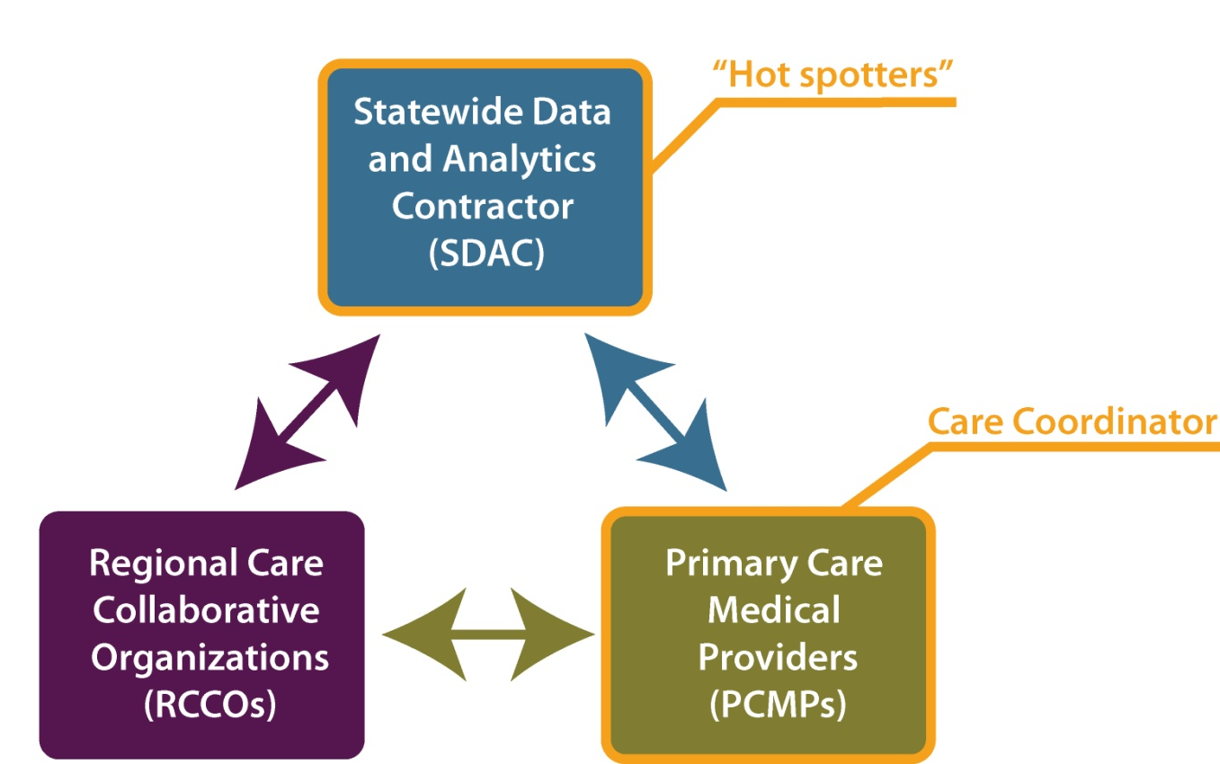
Medicaid Accountable Care Collaborative

Slide 25
ACC ‘s Impact on Controlling Costs
Preliminary estimates on cost savings show some decreases in utilization but data are limited
Future opportunities for savings
Proposed “gainsharing” incentive payments
Dual eligible enrollment

Slide 26
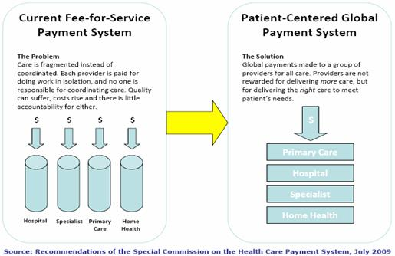
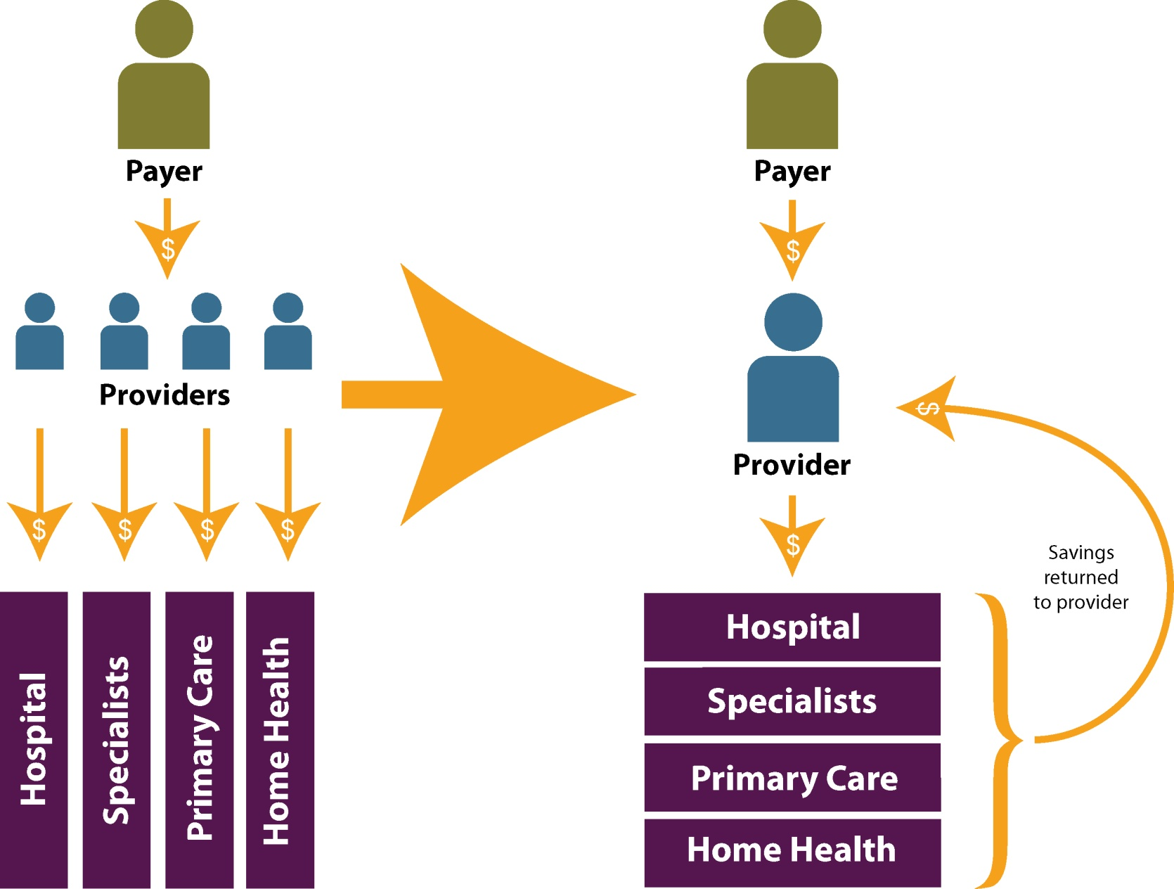
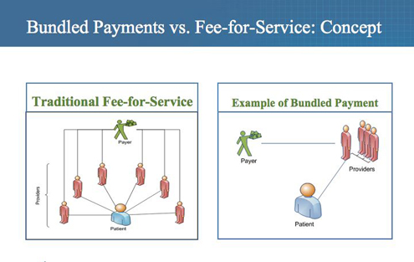
Payment Reform: Moving From Volume to Value

Slide 27
Accountable Care Organizations
Provider networks that are responsible for controlling costs through rewards and penalties
Current efforts
Medicare Shared Savings Programs
Pioneer ACO Model
Medicare ACO demonstration found limited evidence of cost savings

Slide 28
Development of Bundled Payments
Bundled payment is fixed amount to providers for specific episode of care.
Still accumulating evidence
RAND’s modeling – of payment reform ideas, bundled payments hold greatest promise
Heart bypass Medicare bundling demonstration
10% decline in bypass surgery costs

Slide 29
PROMETHEUS Pilot Program in Colorado
Pilot implemented in CO by Health Care Incentives Improvement Institute and Colorado Business Group on Health
Providers financially encouraged to reduce potentially avoidable complications (PACs)
Testing bundled payments concept in San Luis Valley, Boulder/Longmont, Colorado Springs

Slide 30
Global Payment
What is Global Payment?
Single, risk-adjusted payment to a responsible provider for patient’s care over fixed period of time
Colorado efforts
Program of All-Inclusive Care for the Elderly (PACE)
HB 1281 Medicaid Payment Reform Pilot Program

Slide 31
Insurance Benefit Design

Slide 32
Engaged Benefit Design Pilot Project
Pilot project at San Luis Valley Regional Medical Center administered by Engaged Public
Pushes levers that impacts demand for services
Incentivizes individuals to use high value services
Dis-incentivizes individuals from using lower value or preference sensitive services
Improves patients’ knowledge of risks and efficacy rates of services through patient decision aids

Slide 33
The Promise of Health Information Technology
Cost savings through increased efficiency, quality and care coordination
Incentive payments
HIT may yield cost savings
Colorado Efforts
Health Information Exchange
Beacon Consortium
All Payer Claims Database

Slide 34
Continuum of Evidence: From Research to Program Implementation

Slide 35
Under Consideration
Pending legislation
HB 1281 Medicaid Payment Reform Pilot Program
SB 23 Improve Eligible Persons Access to PACE Program
SB 127 Medicaid Health Homes Long Term Care Providers
SB 128 Alternative Care Facility Reimbursement Pilot
HCPF budget proposal for ACC gain-sharing model

Slide 36
The Cost of Doing Nothing
“The unrelenting rise in medical costs is likely to wreck havoc within the system and beyond it, and pretty much everyone will be affected, directly or indirectly.”
Reed Abelson, The New York Times, Feb. 28, 2010
Michele Lueck 720.382.7073 lueckm@coloradohealthinstitute.org

