Slide 1
Reining in Growth of Health Spending
February 16, 2012
2012 Health Policy Roundtables

Slide 2
Today’s Discussion
What are Colorado’s health care cost trends?
What are the drivers?
How to move from idea to implementation?
What’s happening in Colorado?

Slide 3
Our Vision
CHI is a trusted and leading source of credible health information for Colorado leaders. Our insight is used to:
Inform policy
Contribute to effective implementation
Support state efforts to improve health
Access
Quality
Value
Prevention

Slide 4
Trends and Why They Matter

Slide 5
Health Care Expenditures are a Growing Share

Slide 6
Both employers and employees bear the burden
SOURCE: Medical Expenditure Panel Survey

Slide 7
Family Premiums: Employees face largest increase

Slide 8
Health Insurance Premiums Compared to Other Economic Indicators

Slide 9
Drivers of Health Care Spending

Slide 10
Health Care Cost Drivers
System pays for volume
Insurance drives utilization
Wealthier countries afford more services
Aging population increases disease prevalence
Inefficiencies abound
SOURCE: Health Care Costs: Key Information on Health Care Costs and their Impact, Kaiser Family Foundation, 2009

Slide 11
“Hot Spotters”

Slide 12
The Skewing of Health Expenditures

Slide 13
Hot Spotter #1: The Elderly
Annual Cost Per Capita

Slide 14
Hot Spotter #2: The Disabled and the Elderly
SOURCE: Colorado Department of Health Care Policy and Financing, Executive Budget Request, Nov. 1, 2011. Rounding results in a total of more than 100 percent.

Slide 15
Hot Spotter #3: Skilled Nursing
SOURCE: Joint Budget Committee, FY2012-13 Staff Budget Briefing, Dec. 15, 2011

Slide 16
What Are We Doing To Address Costs?

Slide 17
Colorado Payment Reform Initiatives

Slide 18
Colorado Payment Reform Initiatives
# | TOPIC | POPULATION | Patient Education | PCP Involvement | IT Data Efficiency | New Care Model (WF) | Payment Change
1 | ACC/RCCO | Medicaid
2 | Low Back | Commercial
3 | CCQIP | Commercial
4 | Boomers | Workforce
5 | Beacon | Western Slope
6 | CCHAP | Kids/ MK
7 | MPMSPCMH | Commercial
8 | Care Transitions (CTI)
9 | Patient Navigator (CPNTP) | Chronic disease
10 | Project RED | Inpatients
11 | ACE Demo | Cardio IP
12 | Bridges (BTE) | Cardiac and diabetes
13 | PQRS | Physicians
14 | Prometheus | Commercial
15 | PPO Pulse | Physicians
16 | PCMH | Chronic condition
17 | Pioneer ACO | All payers
18 | Safety Net MH (SNMHI) | Vulnerable
SOURCE: Center for Improving Value in Health Care (CIVHC), September 2011

Slide 19
Various Ways to Test Cost Savings
Medical homes
Accountable Care: Public and Private
Payment Change: Global and bundled

Slide 20
#1: Medical Homes

Slide 21
Colorado Medical Home Efforts
Medical Home Initiative for Children
Medicaid and CHP+
Multi-payer, Multi-state Patient Centered Medical Home Initiative
Medicaid, CoverColorado and five private payers
Safety Net Medical Home Initiative Demonstration
Fourteen safety net clinics

Slide 22
Medical Home: Impact on Controlling Costs
CMHI demonstrates savings but targeted to lower-cost populations
Colorado programs still being evaluated, early returns and national results encouraging
Complex, lengthy, resource-intense process for practices to become medical homes

Slide 23
Various Ways to Test Cost Savings
Medical homes
Accountable Care: Public and Private
Payment Change: Global and Bundled

Slide 24
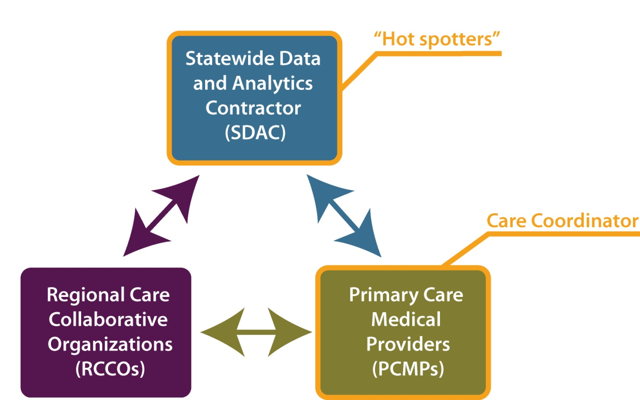
Medicaid Accountable Care Collaborative

Slide 25
ACC ‘s Impact on Controlling Costs
Preliminary estimates on cost savings show some decreases in utilization but data are limited
Future opportunities for savings
Proposed “gainsharing” incentive payments
Dual eligible enrollment

Slide 26
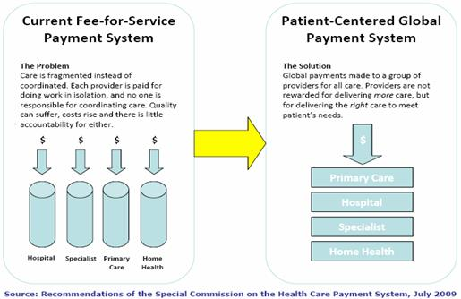
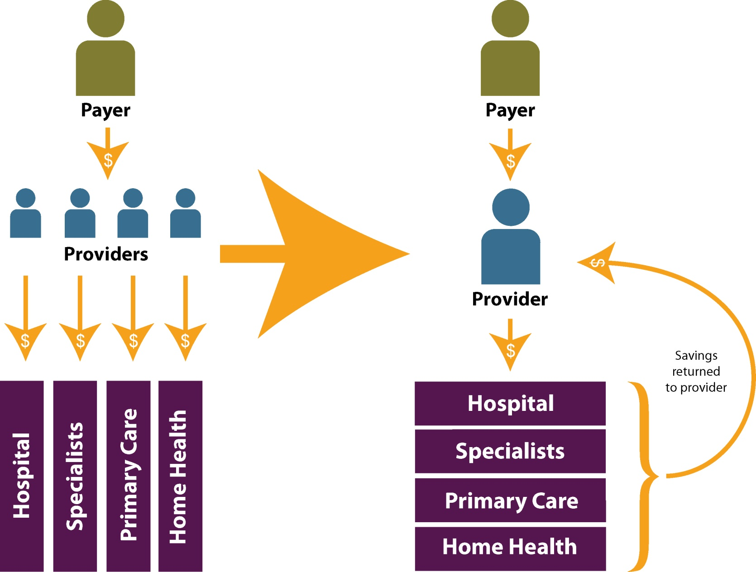
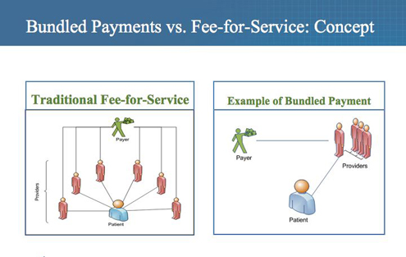
Payment Reform: Moving From Volume to Value

Slide 27
Accountable Care Organizations
Provider networks that are responsible for controlling costs through rewards and penalties
Current efforts
Medicare Shared Savings Programs
Pioneer ACO Model
Medicare ACO demonstration found limited evidence of cost savings

Slide 28
Various Ways to Test Cost Savings
Medical homes
Accountable Care: Public and Private
Payment Change: Global and Bundled

Slide 29
Development of Bundled Payments
Bundled payment is fixed amount to providers for specific episode of care.
Still accumulating evidence
RAND’s modeling – of payment reform ideas, bundled payments hold greatest promise
Heart bypass Medicare bundling demonstration
10% decline in bypass surgery costs

Slide 30
PROMETHEUS Pilot Program in Colorado
Pilot implemented in CO by Health Care Incentives Improvement Institute and Colorado Business Group on Health
Providers financially encouraged to reduce potentially avoidable complications (PACs)
Testing bundled payments concept in San Luis Valley, Boulder/Longmont, Colorado Springs

Slide 31
Global Payment
What is Global Payment?
Single, risk-adjusted payment to a responsible provider for patient’s care over fixed period of time
Colorado efforts
Program of All-Inclusive Care for the Elderly (PACE)
HB 1281 Medicaid Payment Reform Pilot Program

Slide 32
On the Horizon
Pilot project at San Luis Valley Regional Medical Center administered by Engaged Public
HIT may yield cost savings
Colorado Efforts
Health Information Exchange
All Payer Claims Database
Beacon Consortium

Slide 33
Legislation Under Consideration
Legislation | Hot Spot Population | Mechanism
HB 1281 Medicaid Payment Reform Pilot Program | Medicaid | Payment Reform
SB 23 Improve Eligible Persons Access to PACE Program | Elderly | New Models of Care
SB 127 Medicaid Health Homes Long Term Care Providers | Long Term Care | New Models of Care
SB 128 Alternative Care Facility Reimbursement Pilot | Skilled Nursing | Payment Reform
HCPF budget proposal for ACC gain-sharing model | Medicaid | Payment Reform

Slide 34
Salud Family Health Centers,
Commerce City
Michele Lueck 303.782.7073 lueckm@coloradohealthinstitute.org

